Slide 1
Omniverse Base Workshop 1 KUKA X IPI
2x 4h Course with examples to
Learn the Basics in Omniverse, USD & Isaac Sim
Enable you to do Robotic model preparation & Simulation
Introduction to IsaacLab

Slide 2
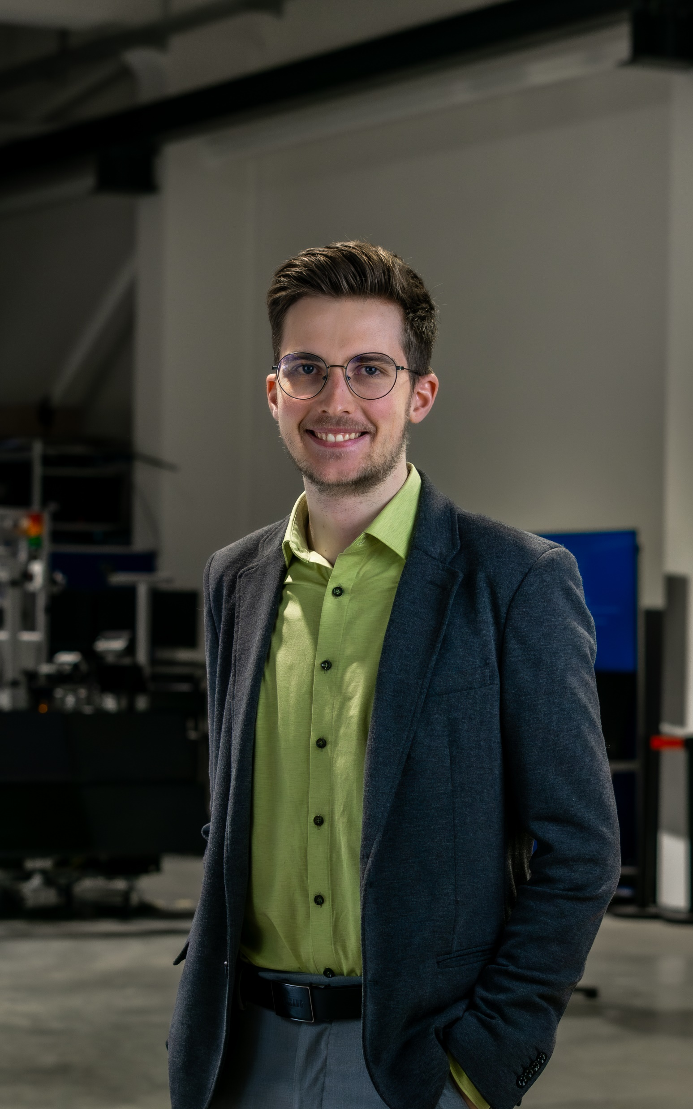
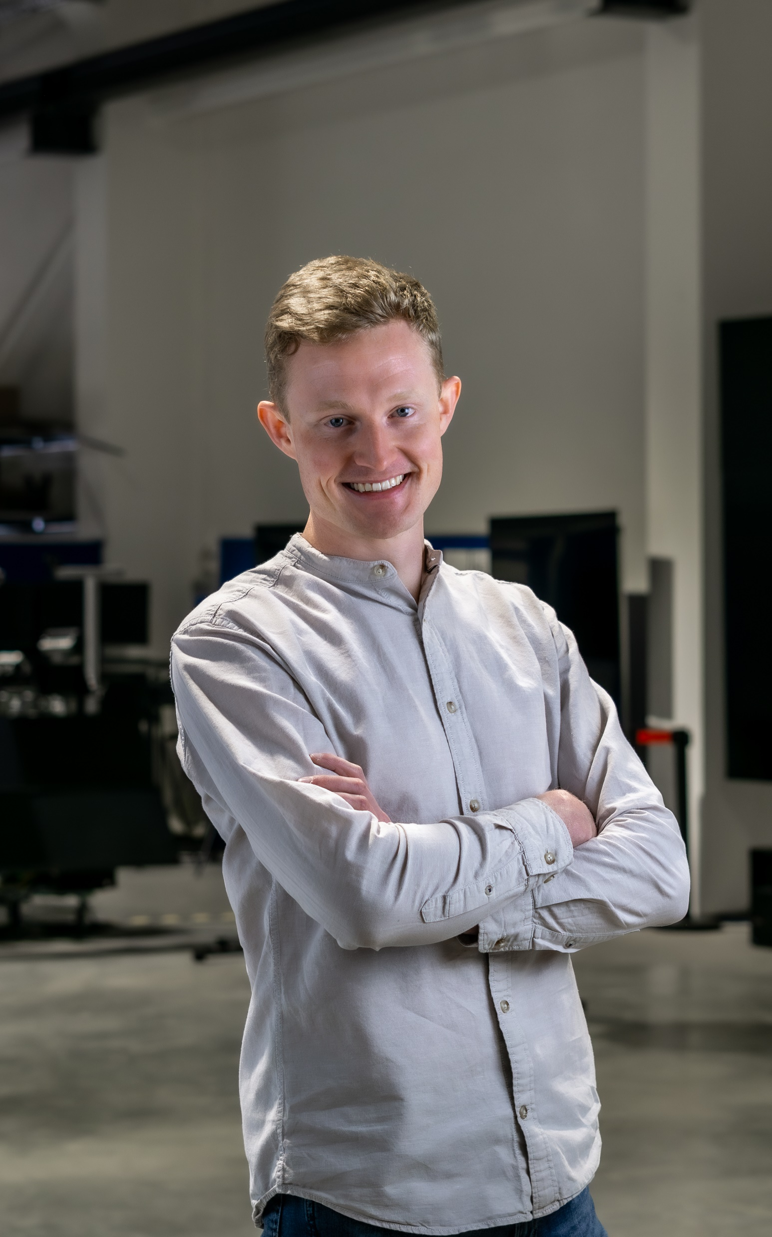
Trainer Introduction
Fabian Fichtl
Julian Zürn

Slide 3
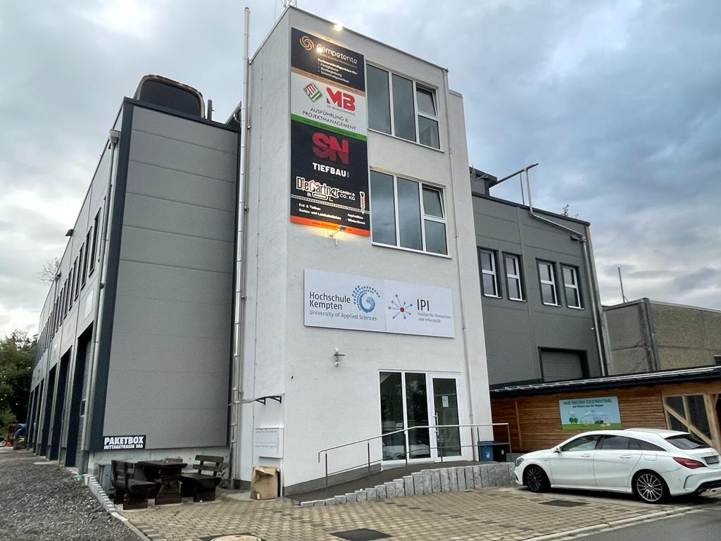

Institut für Produktion und Informatik
Technologietransferzentrum der Hochschule Kempten
anwendungsorientierte Forschungseinrichtung
F&E-Projekte im Kontext Digitalisierung in der Produktion
Seit 2021 mit 30 Mitarbeitern
Technologietransfer und Startup Inkubator
VIBN und Industrial Metaverse in der Lehre

Slide 4
Introduction round
Please tell a few sentences about yourself, what you expect from this workshop and what you want to use Omniverse for

Slide 5
Agenda Tag 1:
Introduction Metaverse
Omniverse basics: Nucleus | Data Formats | PhysX| extensions | Stage
5 min Pause
Hands on: Scene manipulation, Kinematics and Assets
UI Manipulation Navigation, Manipulation (property window)
Mass & Mesh manipulation
First Robot
10 min Pause
Import and Tune a Robot
5 min Pause
First Robot Control (LULA test widget)
Adding Sensors and Kameras
Notes:
Timeline

Slide 6
Agenda Tag 2:
Debugging Tools:
Console, VS Code, UI
Scene Architecture
Build your Scenario: Robot, Gripper, Controller, Environment, Handle Object
Pick & Place
Information Channels | Further Courses
Notes:
Timeline

Slide 7
Introduction to Omniverse

Slide 8
Concept: Industrial Metaverse
Virtual Environment
Real-time Interaction and Collaboration
Purpose can span the Design, Simulation, Observation or Replay of arbitrary Objects and Processes in any Industry
The NVIDIA Omniverse platform is optimized to run 3D physics Simulations in real-time on NVIDIA RTX Hardware

Slide 9
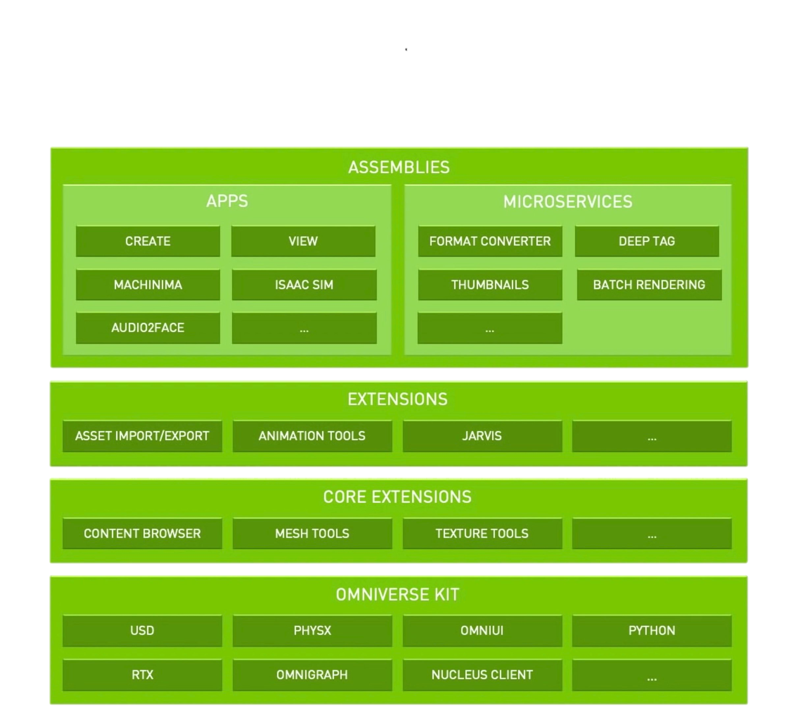
Omniverse Architecture

Slide 10
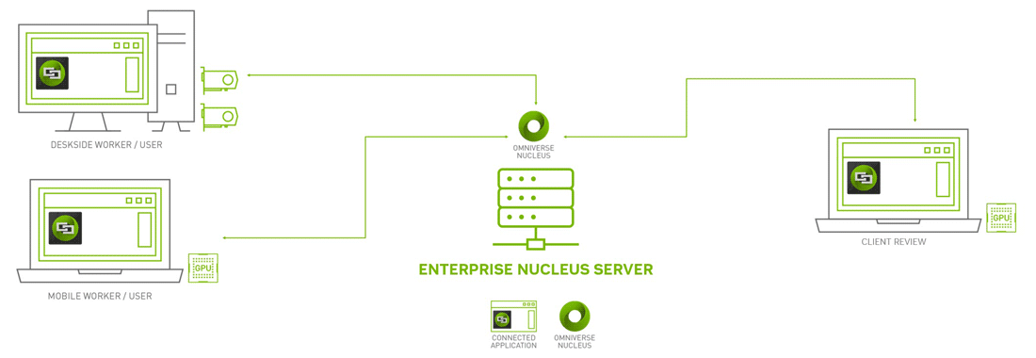
Nucleus – The Omniverse Database
Enables Real-time Collaboration
Comprehensive User/Permission Management
Caching Mechanism for large Assets
Wide API and Script Integration
Enterprise Scalability
Overview — Omniverse Deployment
Notes:
Gutes Bild, rechtlich nicht verwendbar: NVIDIA_Omniverse_Pipeline-1024x517.png (1024×517)
Enterprise Scalability (500 Concurrent Users, Up to 30 editing Users per Session, SSO and SSL Support)

Slide 11

NVIDIA Isaac Ecosystem
IsaacLab (Open Source)
RL Assets and Environments
Tasking Framework
Domain Randomization and Terrain Generation
Imitation Learning
…
Omniverse
Physics
Rendering
UI
USD
Viewport
Isaac Sim (Closed Source)
Visual Coding (OmniGraph)
Robot Assembler
ROS
Synthetic Data Generation
URDF Compatibility
Isaac
Automator
Notes:
Foundation of the Ecosystem is Omniverse, providing general capabilities
Isaac Sim builds upon this, providing robotics support and coding tools
Isaac Lab utilizes these capabilities to provide a state-of-the-art robotics learning framework
(With ist introduction, Isaac Lab deprecates the previous IsaacGymEnvs, OmniIsaacGymEnvs and Orbit frameworks)
All of this can be deployed in cloud infrastructures with the Isaac Automator
For managing multi-stage and multi-container setups NVIDIA provides OSMO (early access)

Slide 12
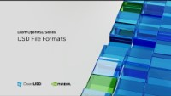
Universal scene description
Notes:
Für uns bedeutet usd ein einheitliches Datenformat das viele Formate ersetzen kann oder an bestehende Datenformate andocken kann und zusätzlich ermöglicht usd komplexe Szenen in einer skalierbarkeit auf der Omniverse Platform wie ich sie noch nicht kannte, bis heute nichts vergleichbares gesehen habe. Der Anfangsaufwand mit usd zu arbeiten gerade mit referenzing, kann anfangs gerade die Lernurve von Omnviverse stark versteilern, jedoch überwiegen später die Vorteile.
Die erwähnte

Slide 13
Interacting with USD (in Omniverse scene)
UI Main Capabilities
Viewport:
Scene
Property Window:
Prim* Properties
Omnigraph:
Process Logic
ROS Controller
Various extensions
API Main Capabilities
Python interface
Robot Controllers
URDF import
Create the scene for IsaacLab
Configure the policy
Start training
*Nodes in the USD-scene tree are called Primitives or Prims

Slide 14
Robot Data formats
 | URDF | SRDF | XRDF
Description Language | XML | XML | YAML
Purpose | Define Geometries and Kinematic Joints | Complements URDF Data with Semantic Grouping | Complements URDF Data with Kinematic Description
Collision Handling | Simple Shapes and Meshes | Collision Matrix (specifies handling for link pairs) | Collision Spheres along Robot Links
Joint Representation | Varying Types and Parameters | Defines Groups for Motion Planning | Advanced Configuration including Acceleration and Jerk Limits
Handling | Core Format in ROS and converted to USD upon import in Isaac Sim | ROS Moveit Assistant to generate Motion Plans | NVIDA CuMotion and Lula to generate Motion Plans

Slide 15
Manual Modelling Phases Robot Simulation
Import URDF and convert to USD
Config Joint drives -> Test
Add Gripper/ Cameras
Add details to the stage of:
URDF for ROS and RL
SRDF for Moveit
XRDF for Cumotion and LULA / RMPflow

Slide 16
NVIDIA PhysX
The PhysX world comprises a collection of Scenes, each containing objects called Actors;
Each Scene defines its own reference frame encompassing all of space and time;
Actors in different Scenes do not interact with each other;
Characters and vehicles are complex specialized objects made from Actors;
Actors have a physical state: position and orientation, velocity or momentum, energy, etc;
Actor physical state may evolve over time due to applied forces, constraints such as joints or contacts, and interactions between Actors.

Slide 17

Omniverse Stage

Slide 18
5 min Break
Until now:
We reviewed necessary Omniverse Basics and Resources
To be continued:
Practical session:
Extensions installation
Scene Manipulation
Robot import + tuning

Slide 19
Hands on!

Slide 20
Getting started:
Start Omniverse Isaac Sim on the Machine
Please give feedback if your application is loaded

Slide 21
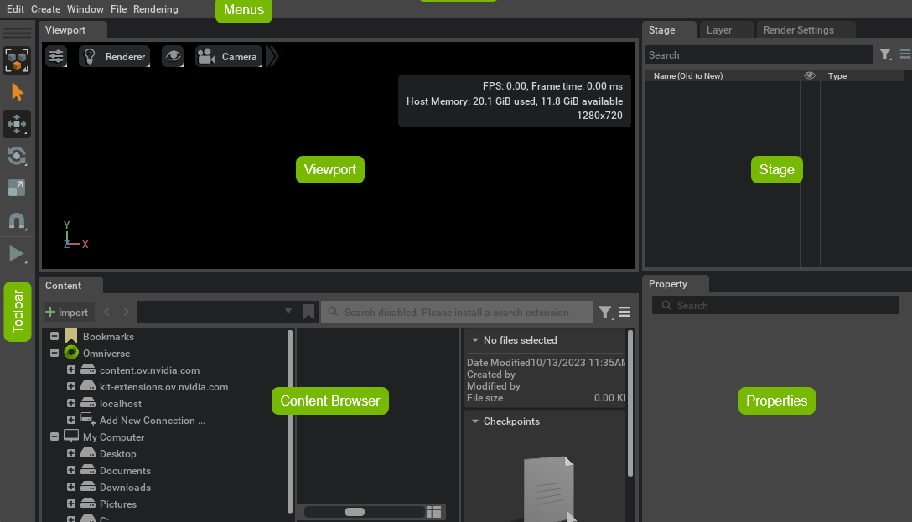
Standard Layout

Slide 22
How-to: Viewport Navigation
Orbit: Left mouse btn. + ALT
Look: Right mouse btn. (RMB)
Fly/ Walk: Hold RMB; WASD / Q up / E down
Adjust Speed Hold RMB; Scroll
Jump to Selection: F

Slide 23
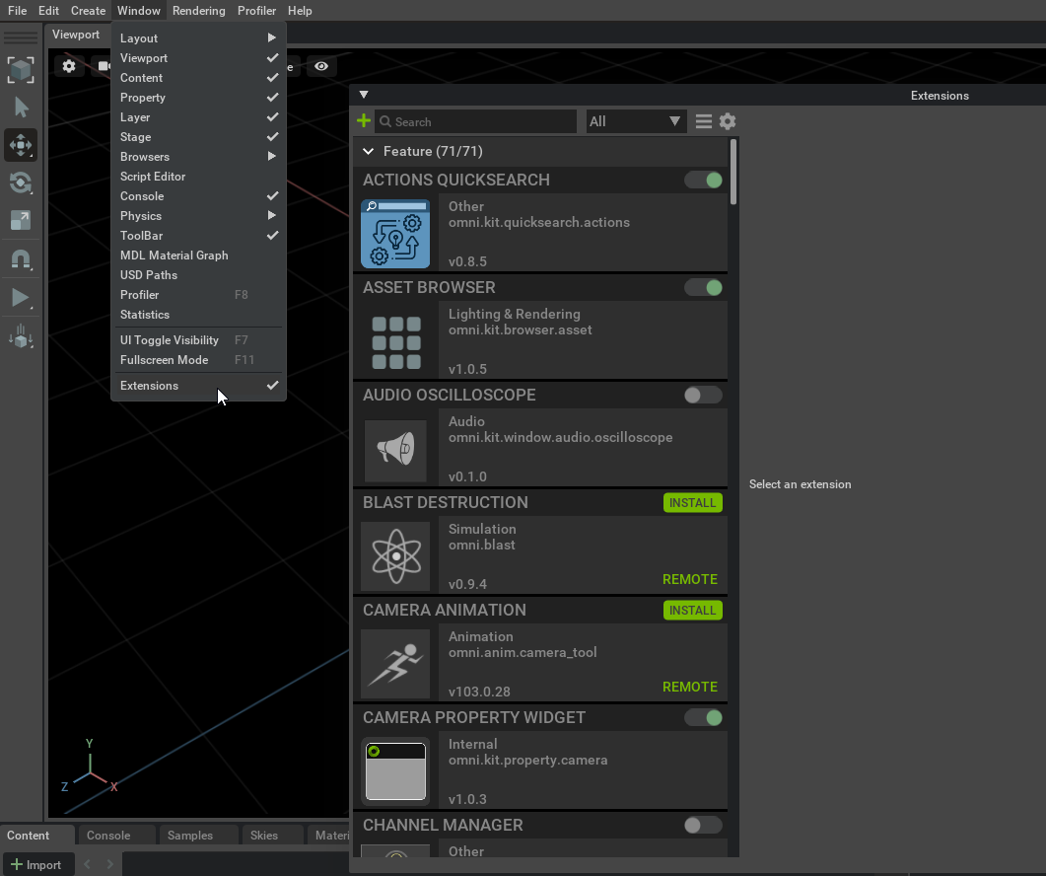
Scene Prep tools (extensions)
Check for extensions:
Action Graph
URDF importer

Slide 24
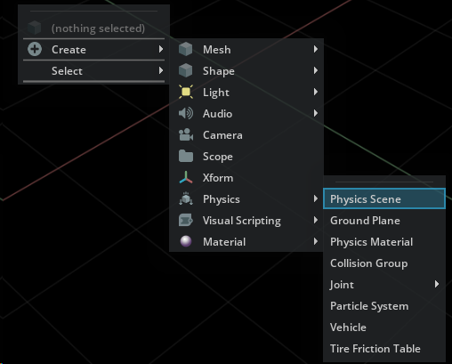
How-to: Add Physics Scene
Create a Physics Scene
Create a ground plane

Slide 25
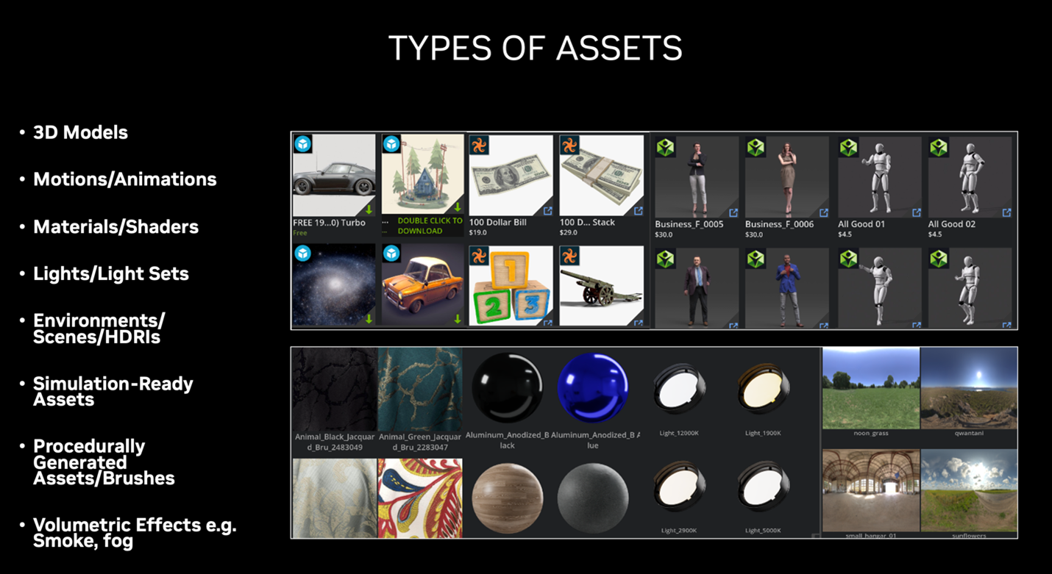
Asset Store
Import a Box
Move above ground plane
Adjust the size
Add (Rigid Body and and Collider)
Press Play to start the Simulation
How-to↓
Notes:
Compare Viewport with property changes

Slide 26
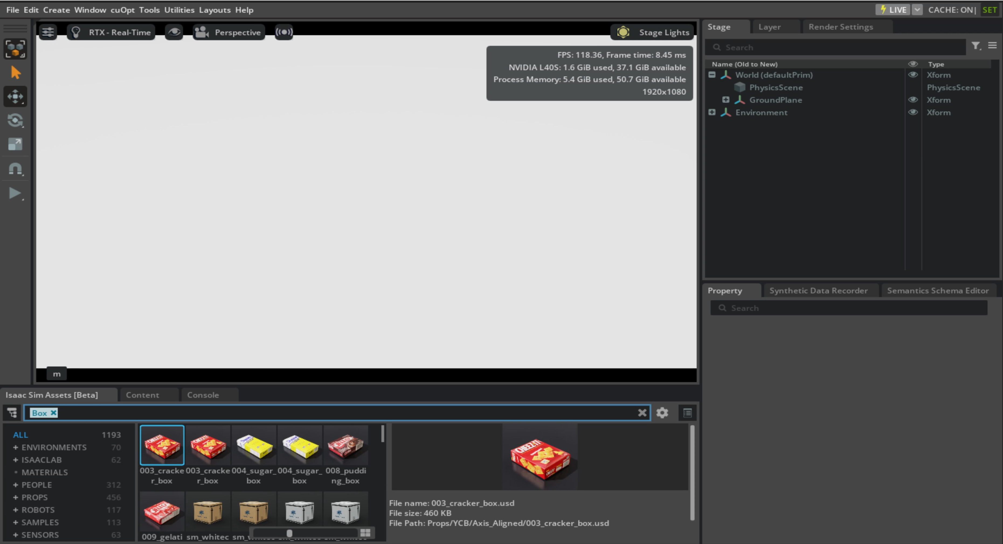
How-to: Use Asset Store
Search
Drag & Drop (to Stage or Viewport)
a
b
1
2
Notes:
11

Slide 27
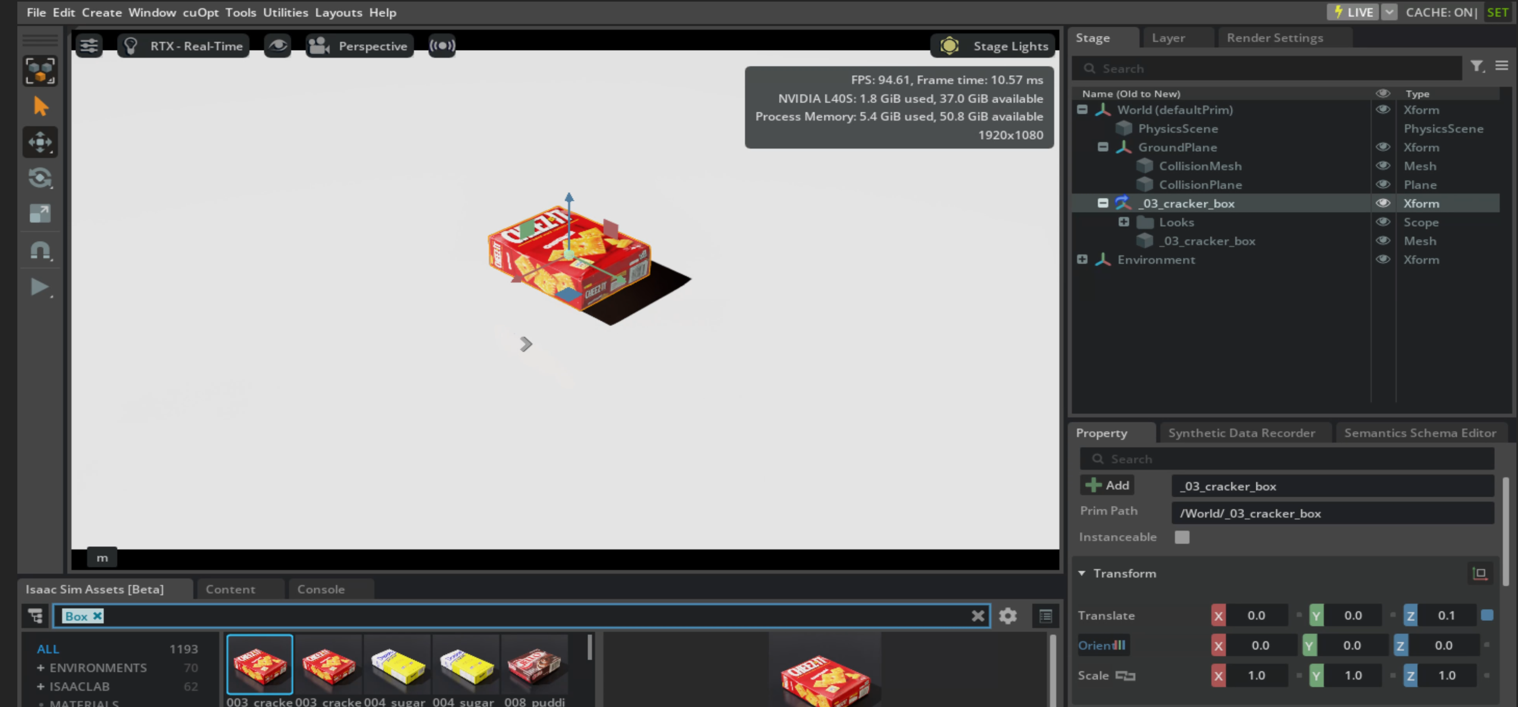
How-to: Manipulation in Viewport
Move Selection* (W)
Rotate Selection* (E)
Scale Selection (R)
Snap Selection* (S)
Update Attributes with value
*RMB on icon shows further options

Slide 28
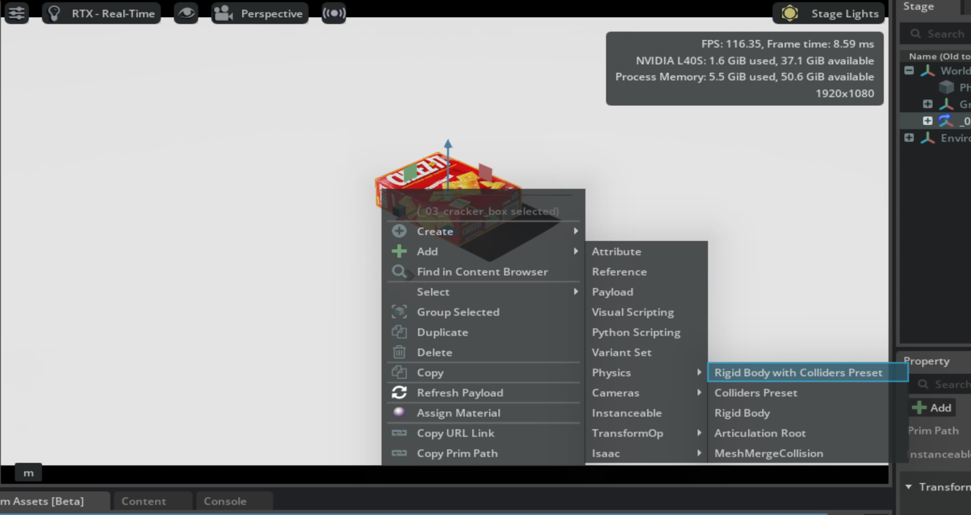
How-to: Add Rigid-body & Collider
Select cracker box XForm in Stage Tree
Use Context menu on box

Slide 29
Asset Store
How-to↑
Import a Box
Move above ground plane
Adjust the size
Add (Rigid Body and and Collider)
Press Play to start the Simulation
Notes:
Compare Viewport with property changes

Slide 30
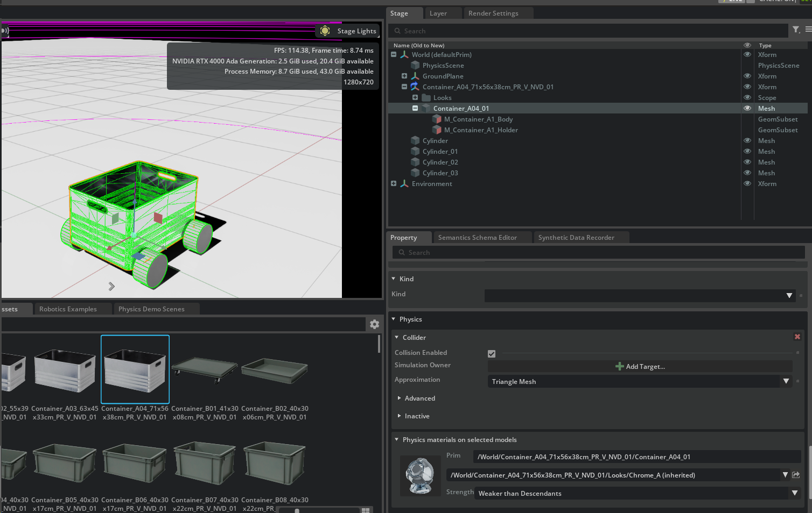
Assemble the first self-built Robot
Stop the Simulation
Create Cylinders
Move/ orient to the side
Create a revolute joint
Add Angular drive
Modify target velocity + stiffness
Start the Simulation
How-to↓

Slide 31
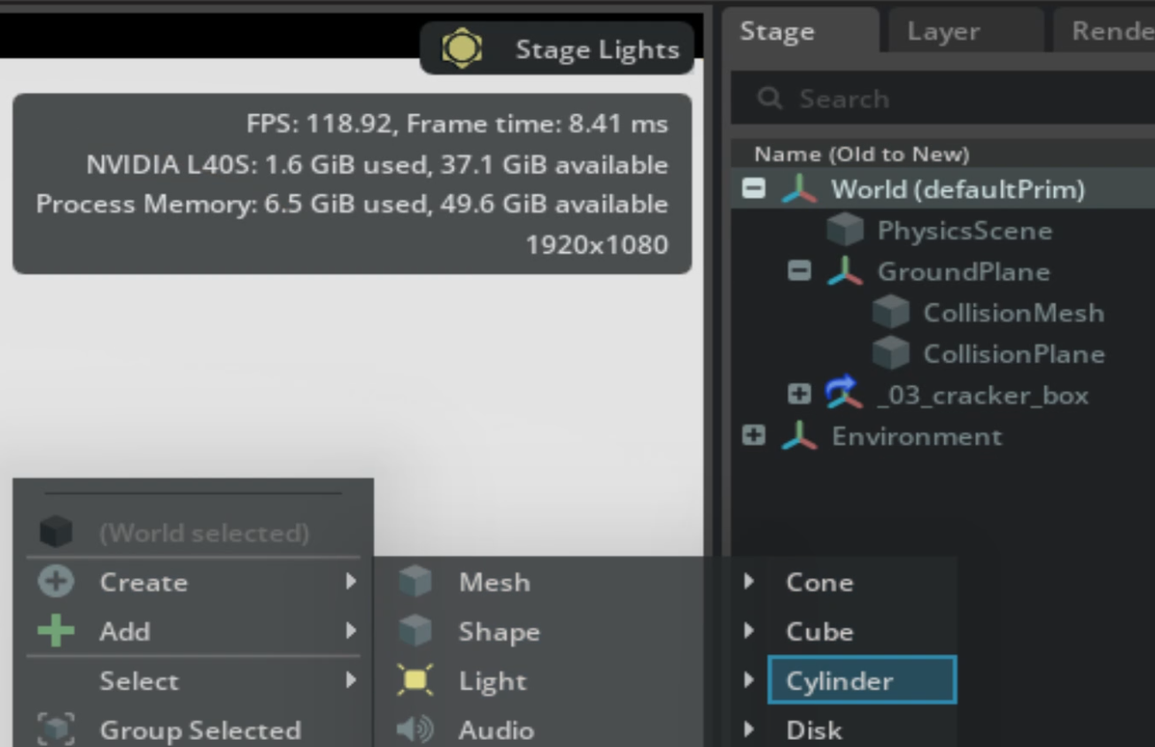
How-to: Add Cylinder
3. Adjust scaling and orientation to represent a wheel
4. Add Rigid Body & Collider
5. Use Ctrl+C and Ctrl+V to replicate the wheel
6. Move the wheels to reasonable positions around the box
Ensure World is selected in Stage
Use Context menu in Viewport or Stage

Slide 32
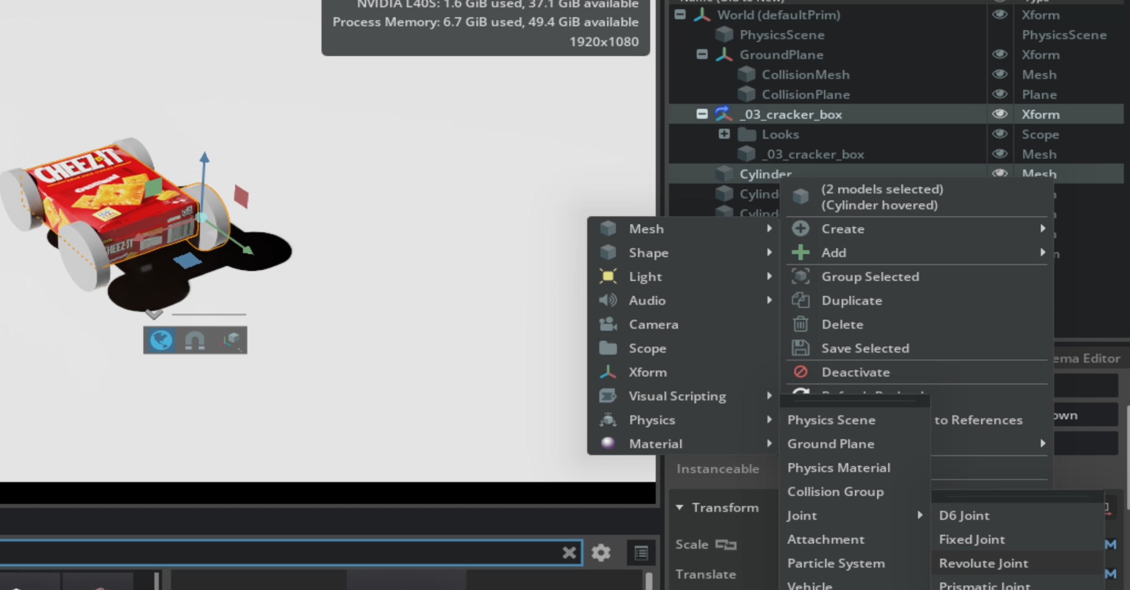
How-to: Add Joint
Holding Ctrl, select the box then the cylinder
Create joint using the context menu
Repeat for all wheels

Slide 33
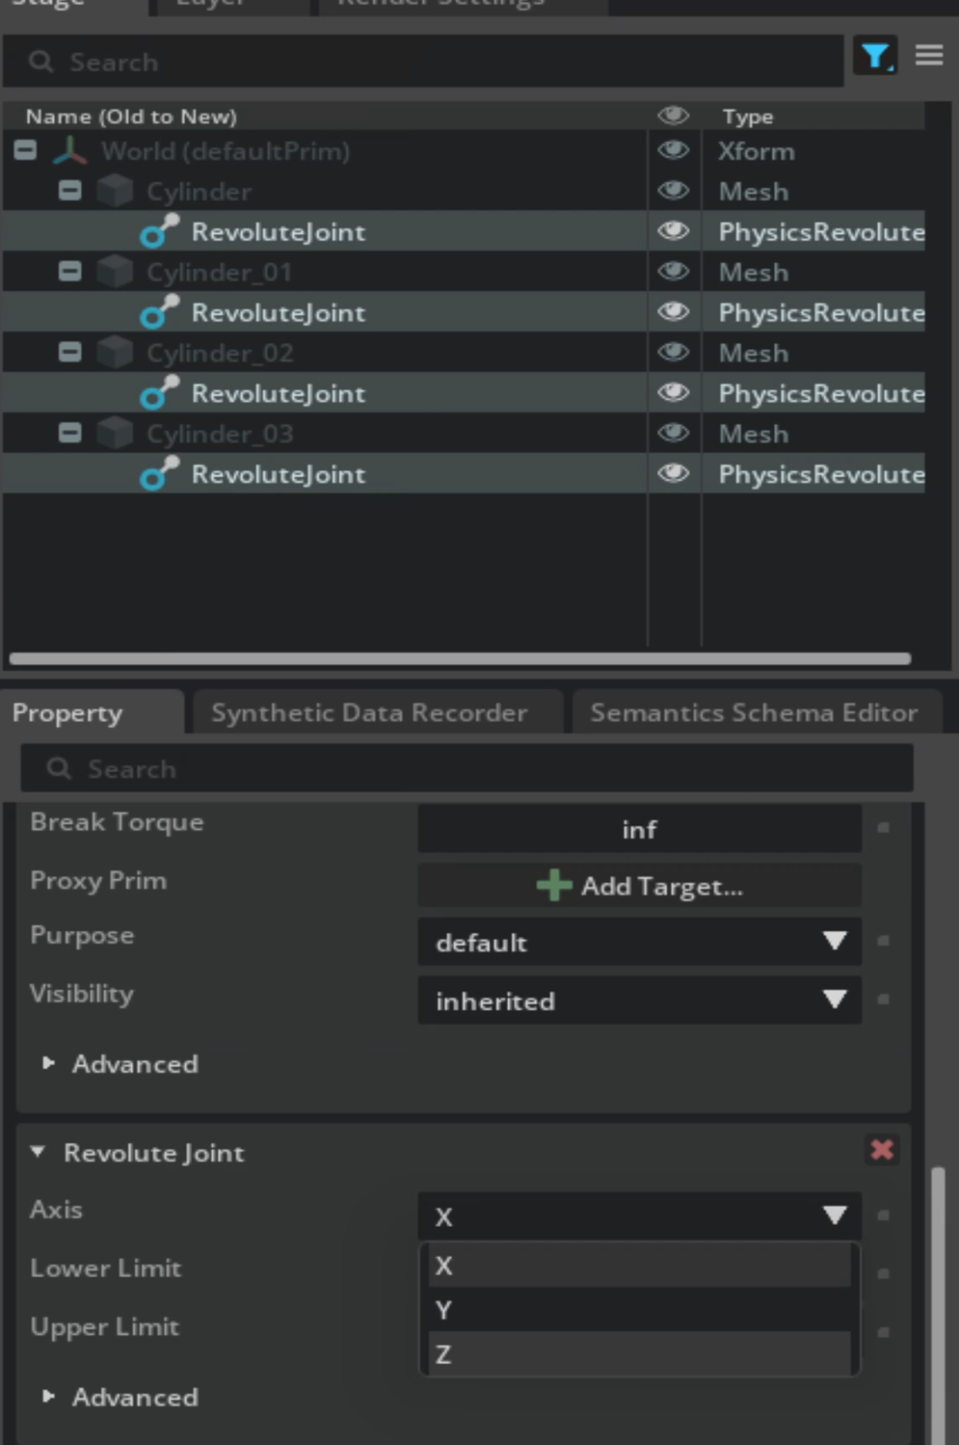
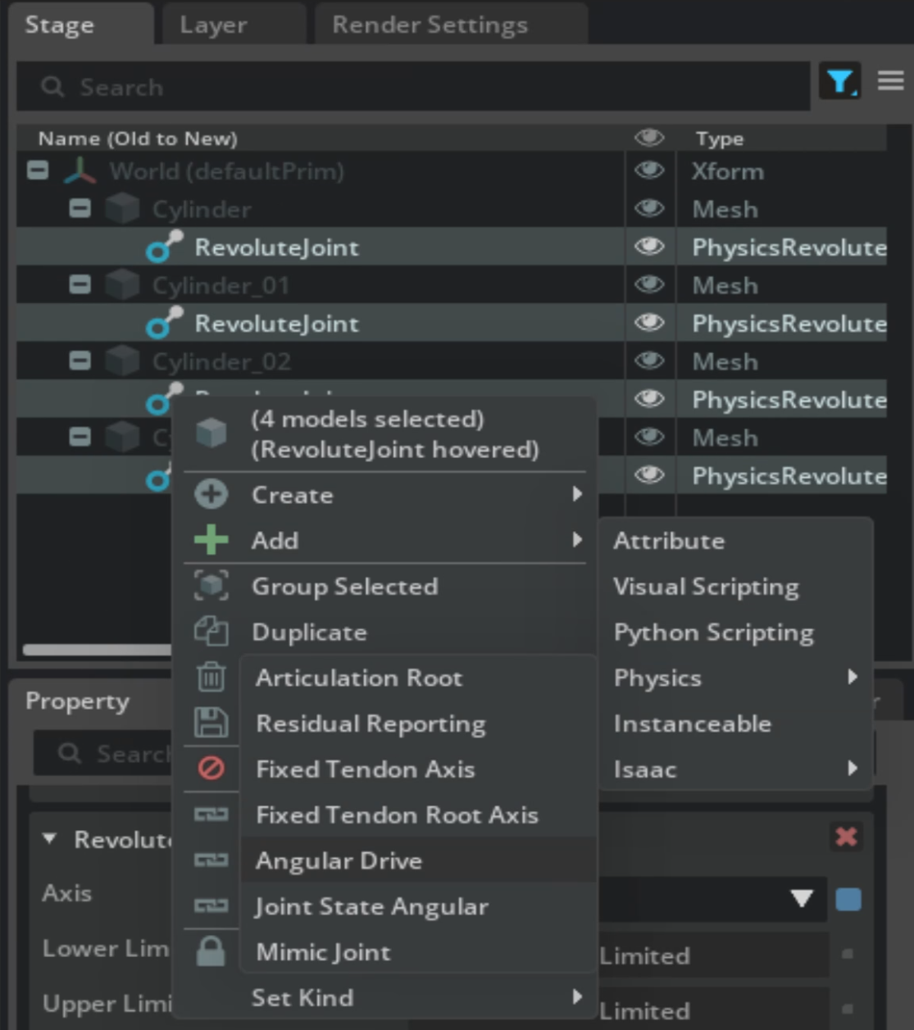
How-to: Adjust Joint and Add Drive
Filter for Joints
Select all joints (via Shift or Ctrl)
Adjust joint rotation
Add Drives to joints (via Context menu)

Slide 34
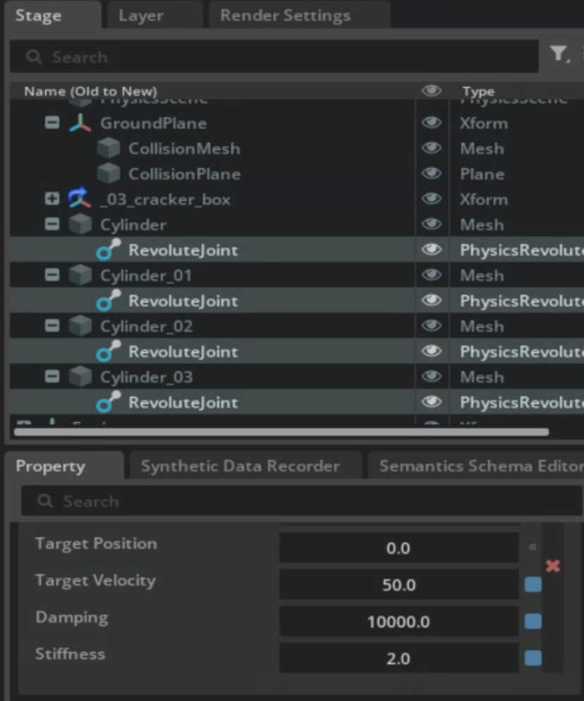
How-to: Adjust Drive
Set a Velocity(~20-100)
Iterate:
Set Damping & Stiffness Values
Restart Simulation for Testing*
*Not restarting the simulation leads to misleading results due to the forces that already applied before the update

Slide 35
Assemble the first self-built Robot
How-to↑
Stop the Simulation
Create Cylinders
Move/ orient to the side
Create a revolute joint
Add Angular drive
Modify target velocity + stiffness
Start the Simulation

Slide 36
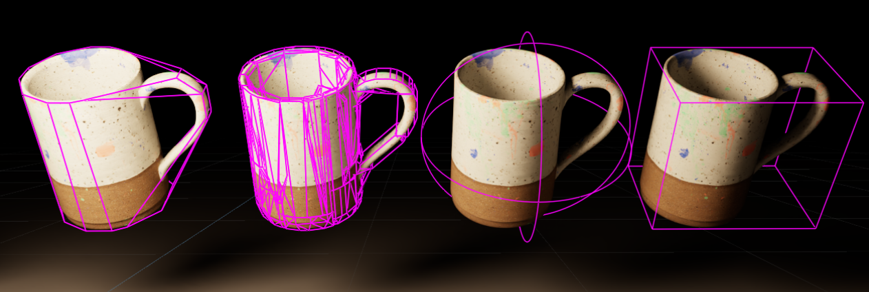
Rigid Bodies and Colliders
Simpler approximation = faster Simulation

Slide 37
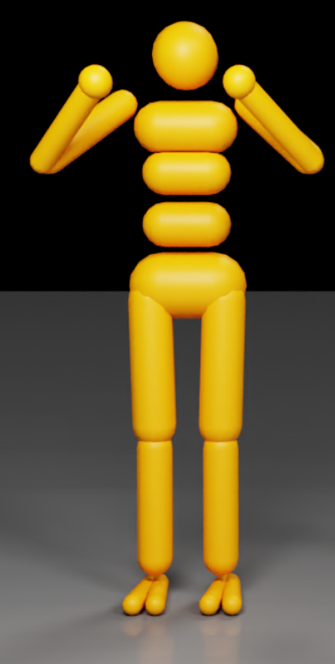
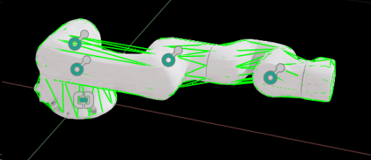
Robot assembly
Structure of mobile / static robot
Articulation chain
root link free / fixed
Link 1
Link 2
Link 3
Link n
Base Link Articulation root
No Base Link

Slide 38
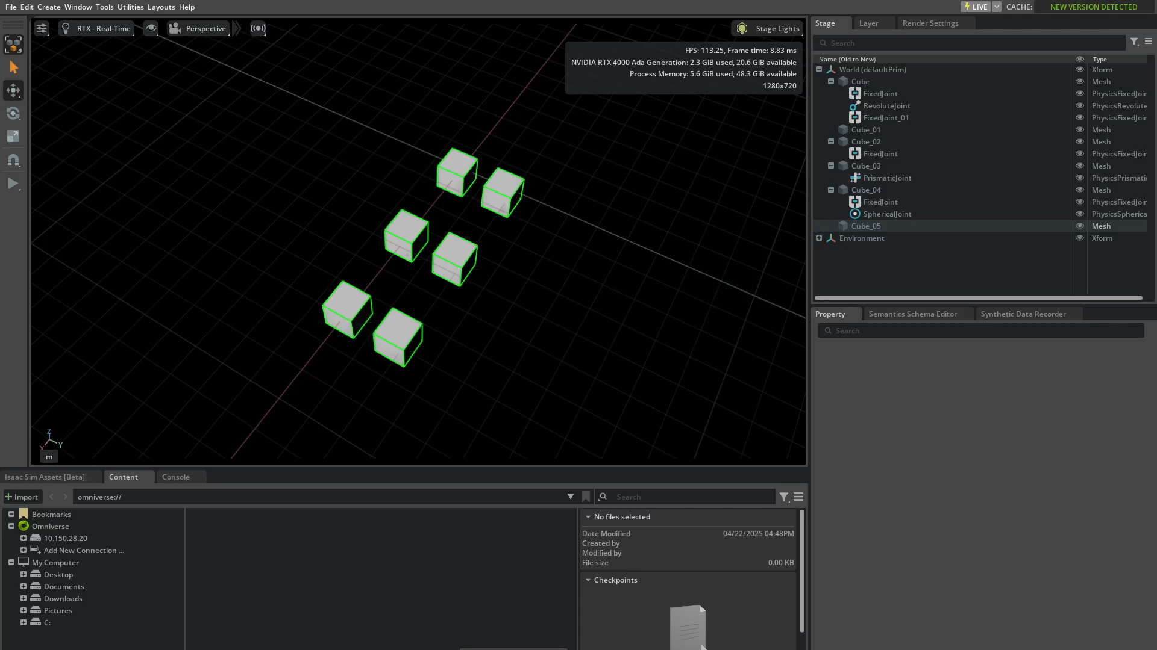
Joint types and properties

Slide 39
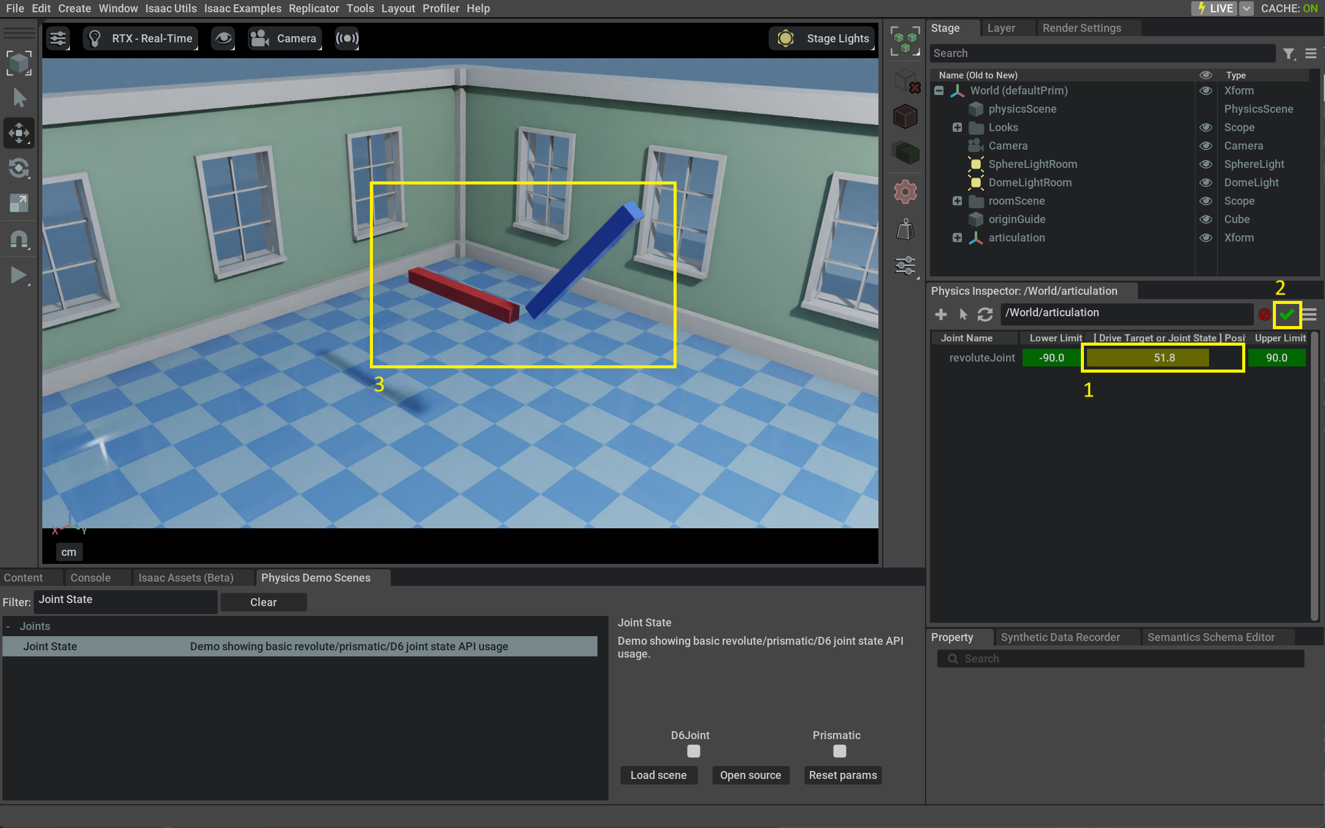
Joints
Notes:
Nicht ins detail gehen

Slide 40
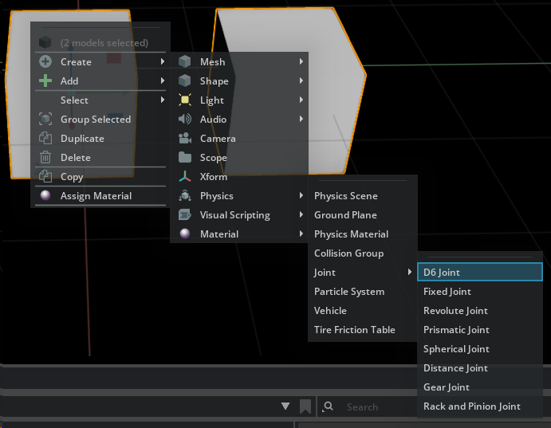
Joint types and properties
Joint drives are internally simulated with PD-Controllers
Stiffness property <-> Proportional coefficient
Damping property <-> Derivative coefficient
⚠This can lead to unexpected behavior at low simulation frequencies

Slide 41
10 min Break
Until now:
We reviewed necessary Omniverse Basics and Resources
Practical session:
Extensions installation
Scene Manipulation
To be continued:
Practical session:
Robot import + tuning

Slide 42
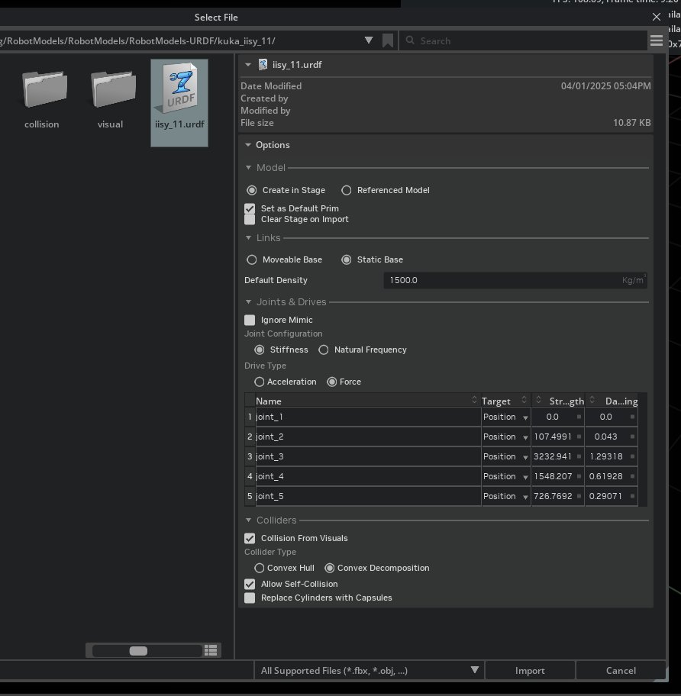
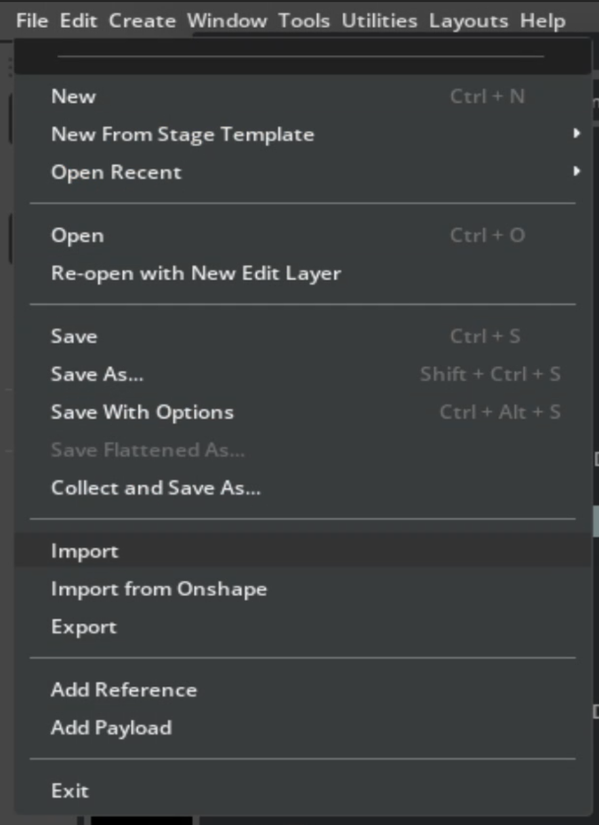
How-to: Starting with a real Robot
Open File->import
Navigate to a URDF File
Modify the Options
Verify Model and Links
Adjust Joints & Drives
Verify Colliders
Click Import
How-to↓

Slide 43
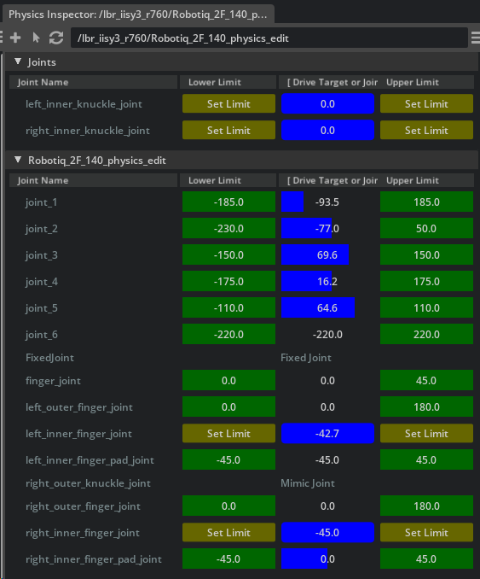
Robot import Tools
LULA URDF Import Tool:
Import Robot URDF
Start scene -> look at joint drives
Physics Inspector Tool:
Activate scene
Choose IISY to inspect-> control joint limits/ direction
Gain tuner:
Adjust Stiffness & Damping and test the parameters
Preparation of self and external collision shape:
Sphere approximation Collider tool for RMP

Slide 44
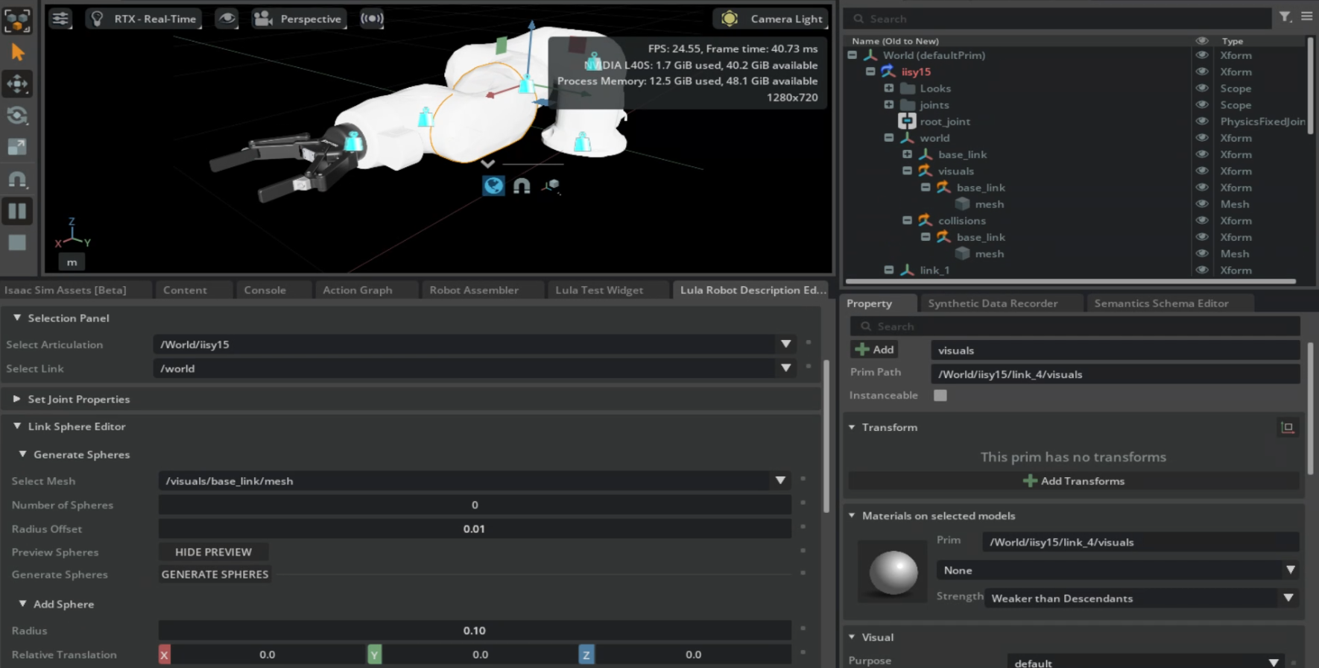
Robot Description Editor

Slide 45
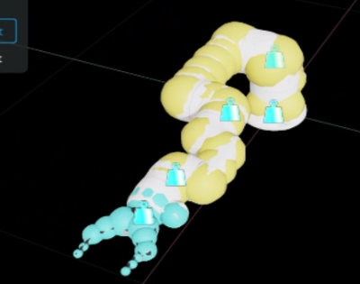
Sphere Approximation Result

Slide 46
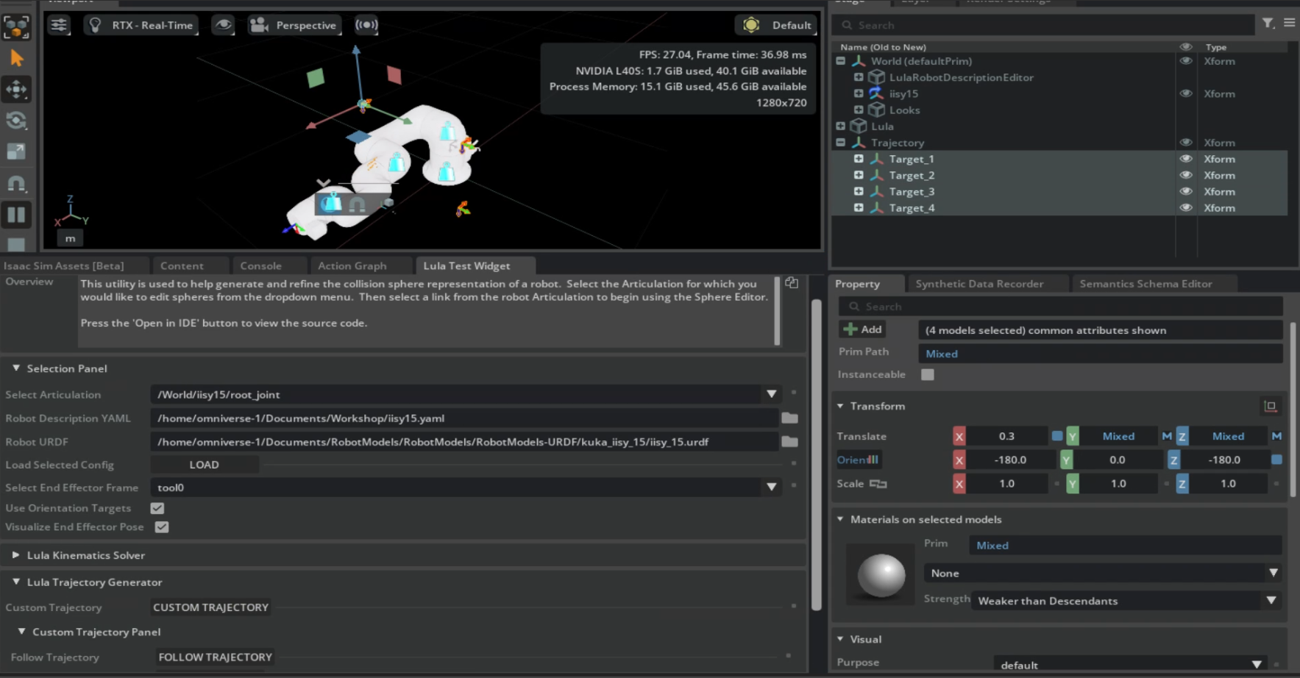
Lula Test Widget

Slide 47
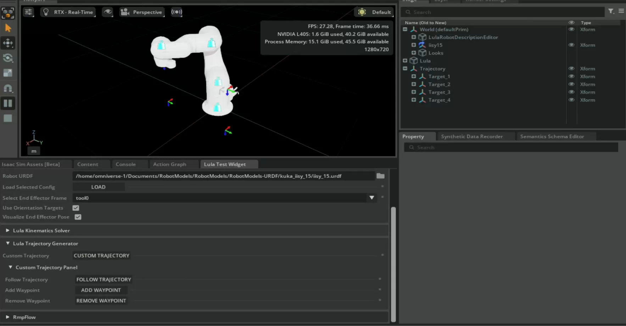
Lula Test Widget

Slide 48
Sensors
Adding a Wrist Camera to the Robot
Tune the Camera

Slide 49

End of Day 1
Please provide some Feedback Verbal or via:
For further questions mail us:
fabian.fichtl@hs-kempten.de
julian.zuern@hs-kempten.de

Slide 50
Omniverse Base Workshop 1 KUKA X IPI
2x 4h Course with examples to
Learn the Basics in Omniverse, USD & Isaac Sim
Enable you to do Robotic model preparation & Simulation
Introduction to IsaacLab

Slide 51
Review of Day 1
We reviewed necessary Omniverse Basics and Resources
Practical session:
Extensions installation
Scene Manipulation
Robot import + tuning

Slide 52
Agenda Tag 2:
Scene Architecture
Build your Scenario: Robot, Gripper, Controller, Environment
Debugging Tools:
Console, VS Code, UI
Materials
Motion Planning & Motion Learning
Practical Session: Pick & Place
Information Channels | Further Courses
Notes:
Timeline

Slide 53
Interacting with USD (in Omniverse scene)
UI Main Capabilities
Viewport:
Scene
Property Window:
Prim* Properties
Omnigraph:
Process Logic
ROS Controller
Various extensions
API Main Capabilities
Python interface
Robot Controllers
URDF import
Create the scene for IsaacLab
Configure the policy
Start training
*Nodes in the USD-scene tree are called Primitives or Prims

Slide 54
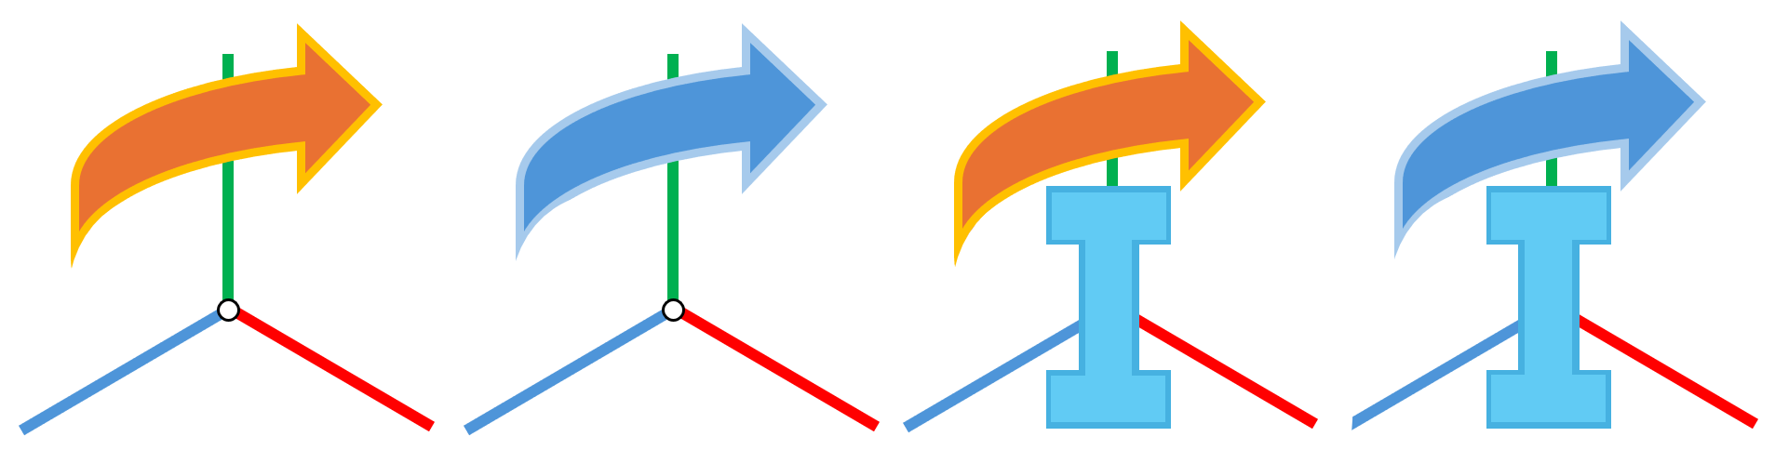
Scene Assembly
Payload: blue ↔ Reference: orange
The user can choose to not load a payload
References always get loaded
I = Instancing active
How to build a reference scene architecture
To test different robots/ grippers
Test Script of Robot Assembly
Repository (Asset store/ Local)
Robot.usd
Scene
Built from References
Gripper.usd
Scene/Objects.usd

Slide 55
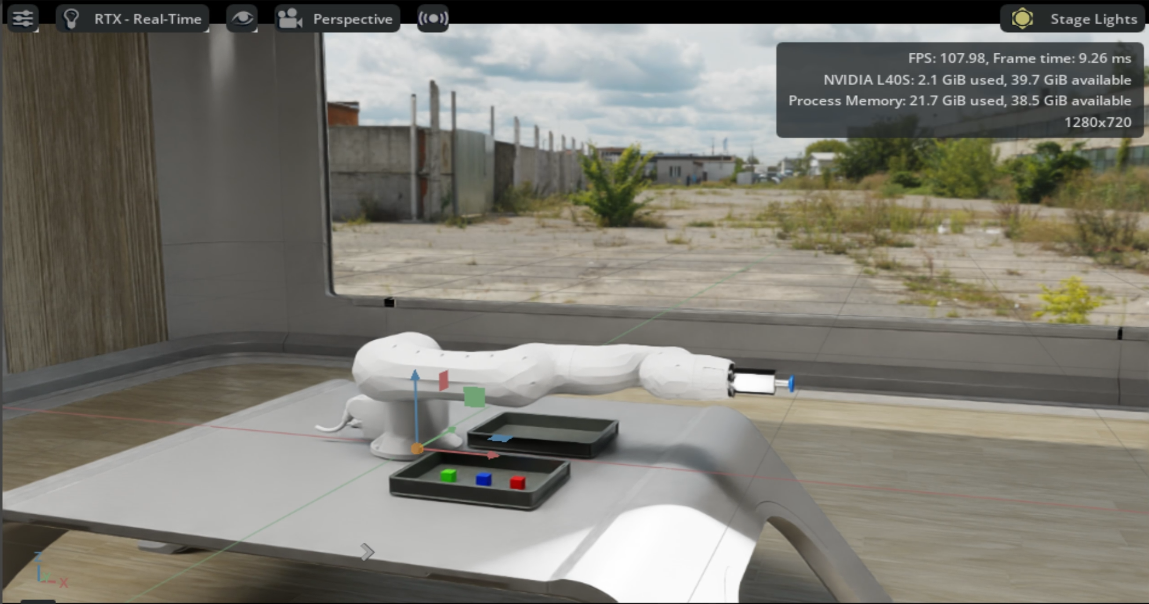
Assemble Your Scene
How-to↓

Slide 56
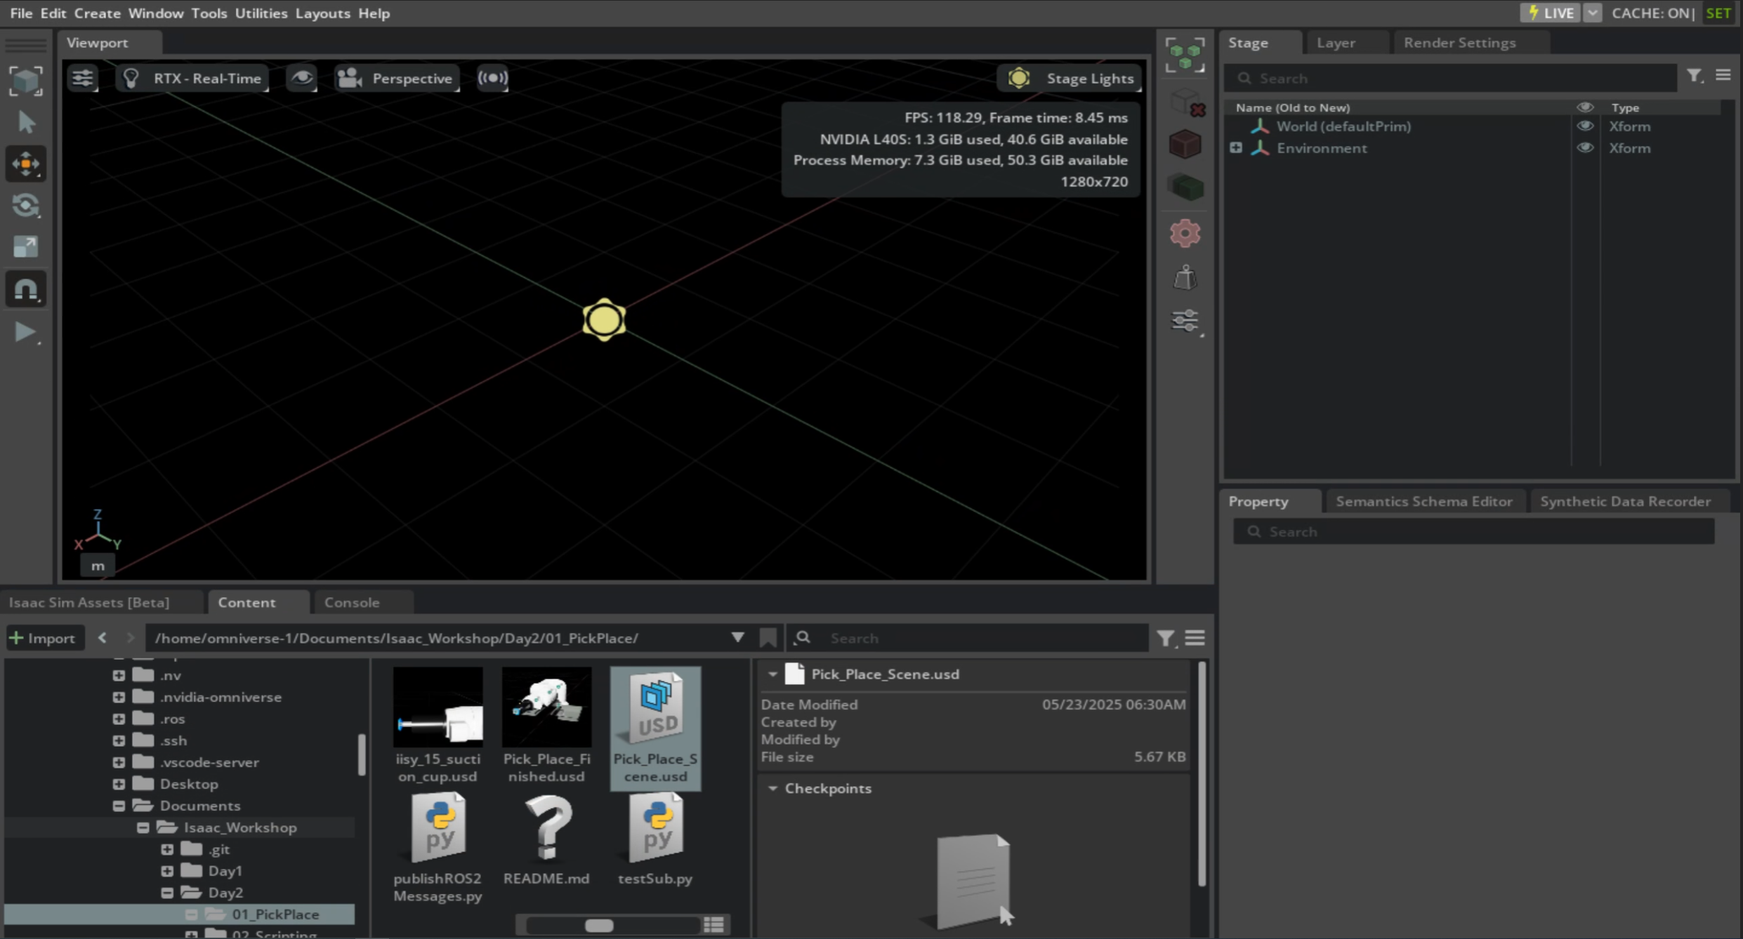
How-to: Add the Environment
1. Drag USD scene from content browser onto Stage tree

Slide 57
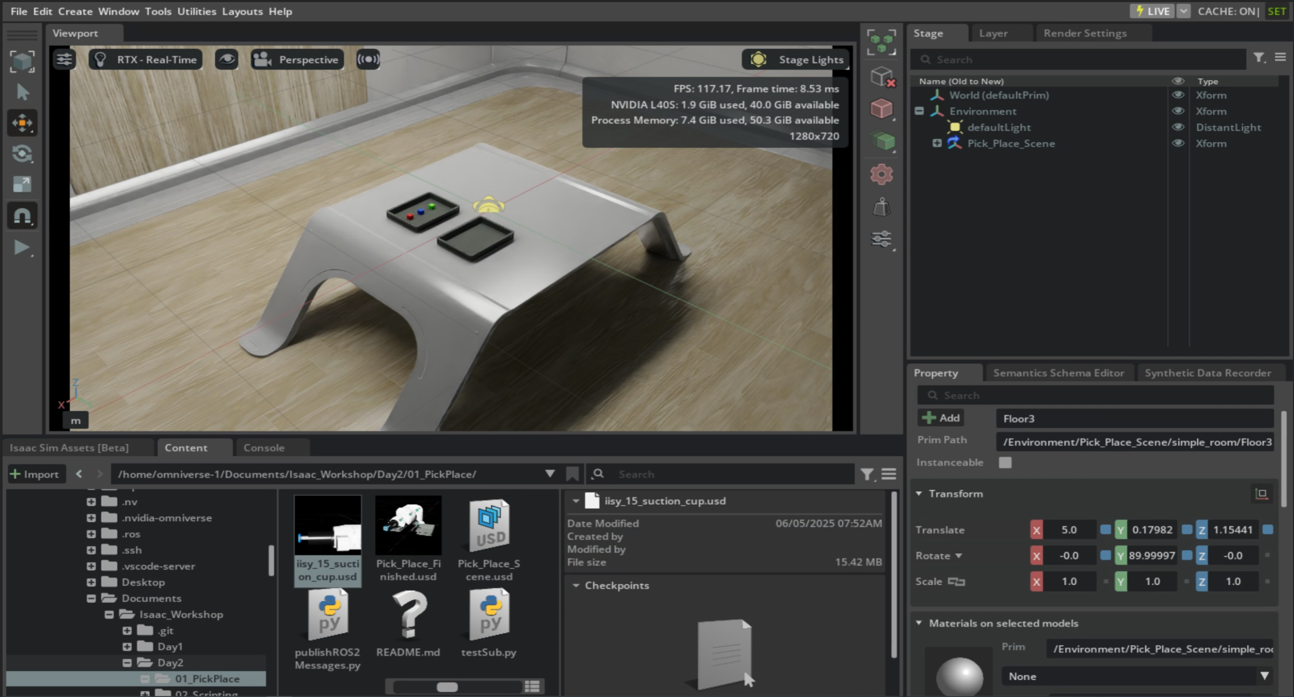
How-to: Add the Robot
1. Drag robot from content browser onto Stage tree

Slide 58
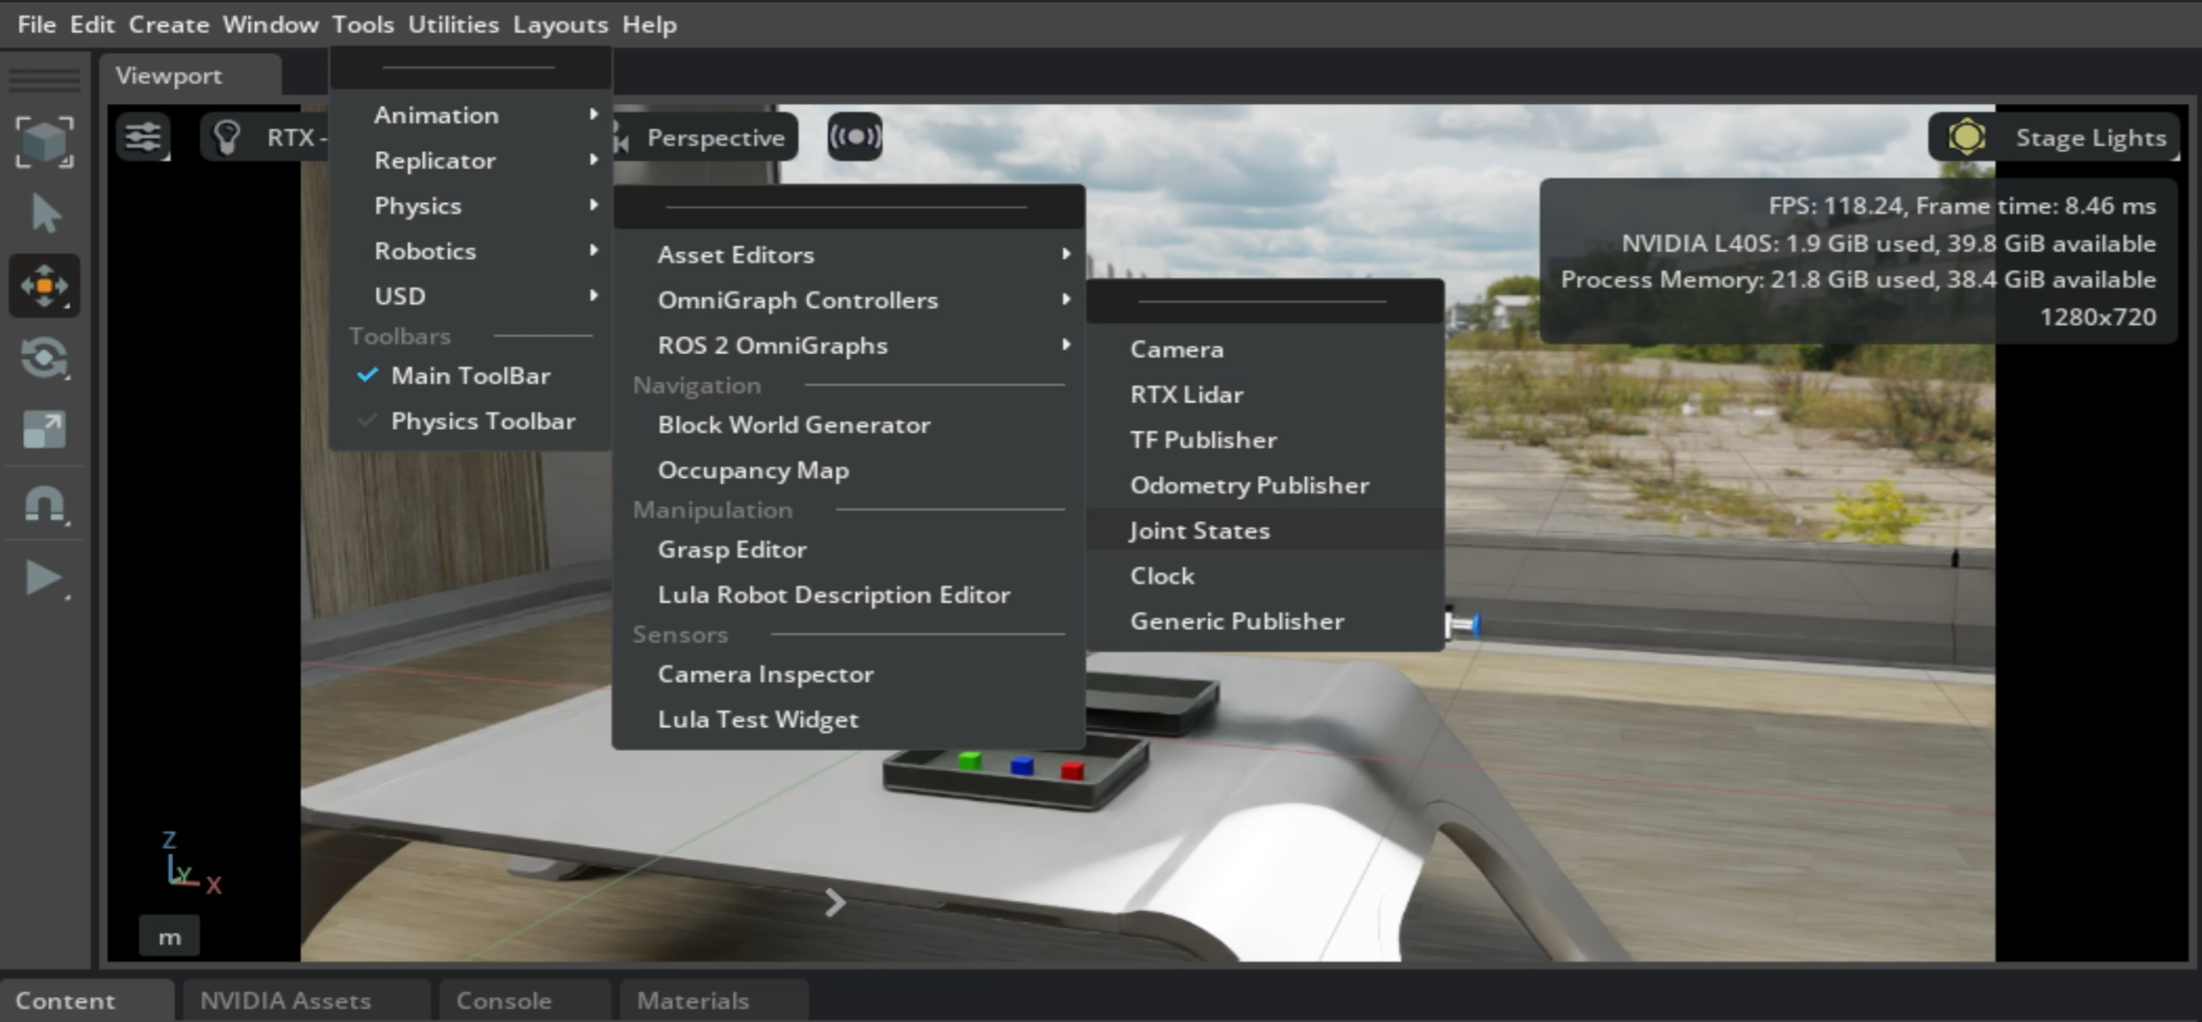
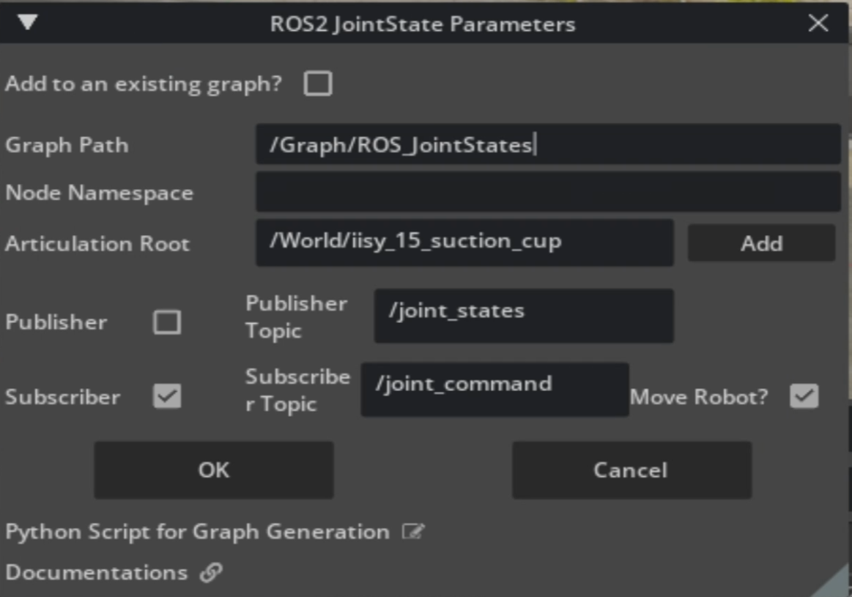
How-to: Add the Controller
Open Graph Assistant
Check Configuration and press ok

Slide 59
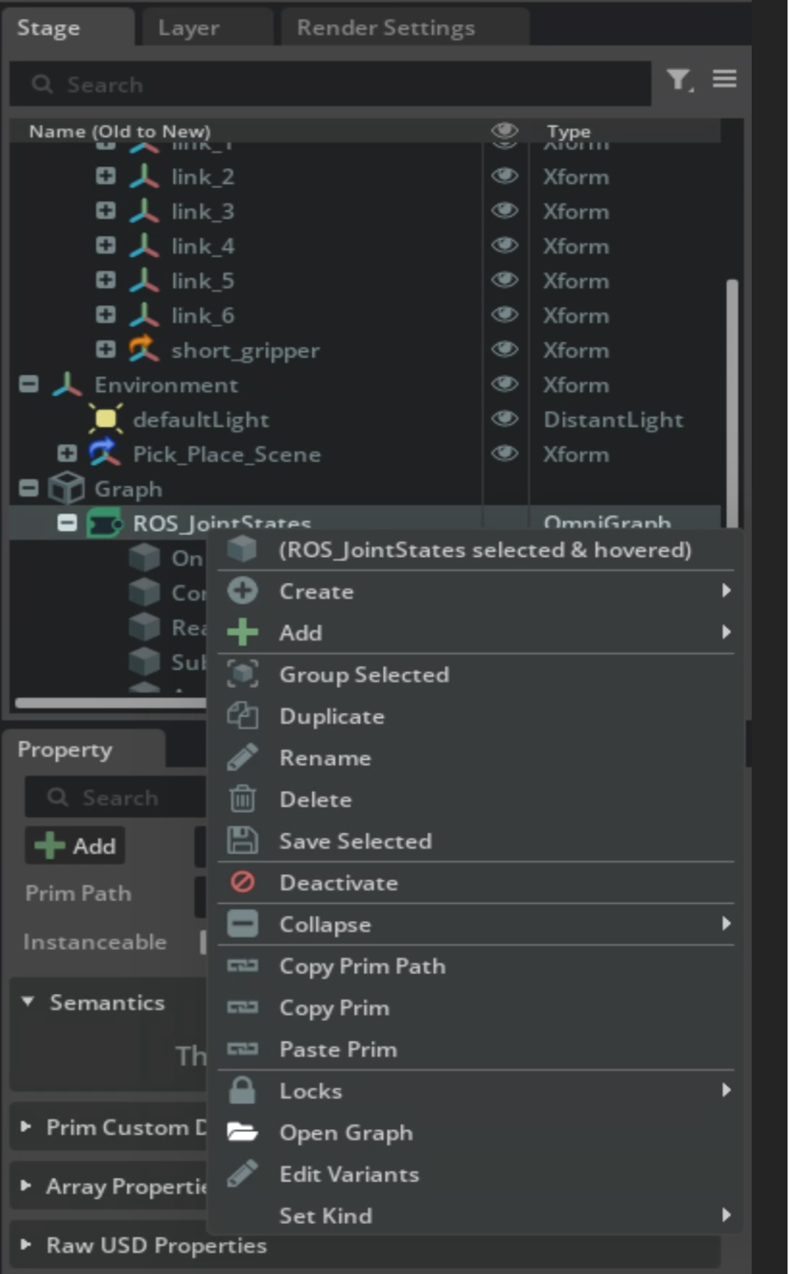
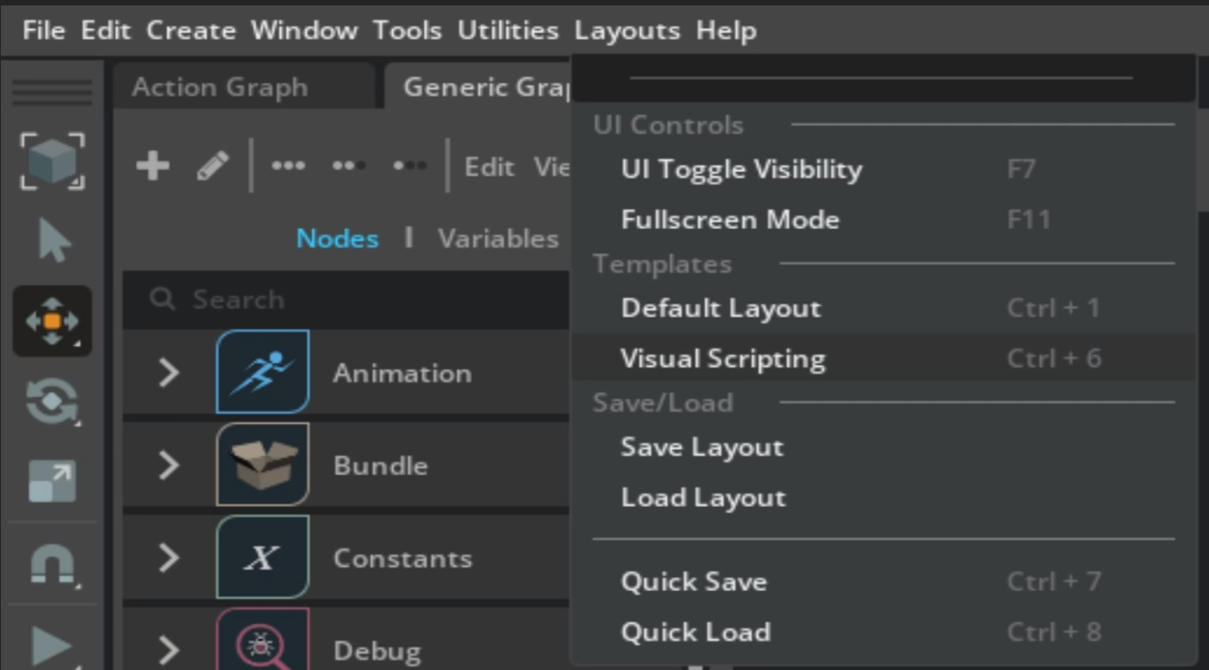
How-to: View the Controller
Use Context menu in Stage
Use Visual Scripting Layout (Ctrl+6 -> ‘Edit Graph’)
or

Slide 60
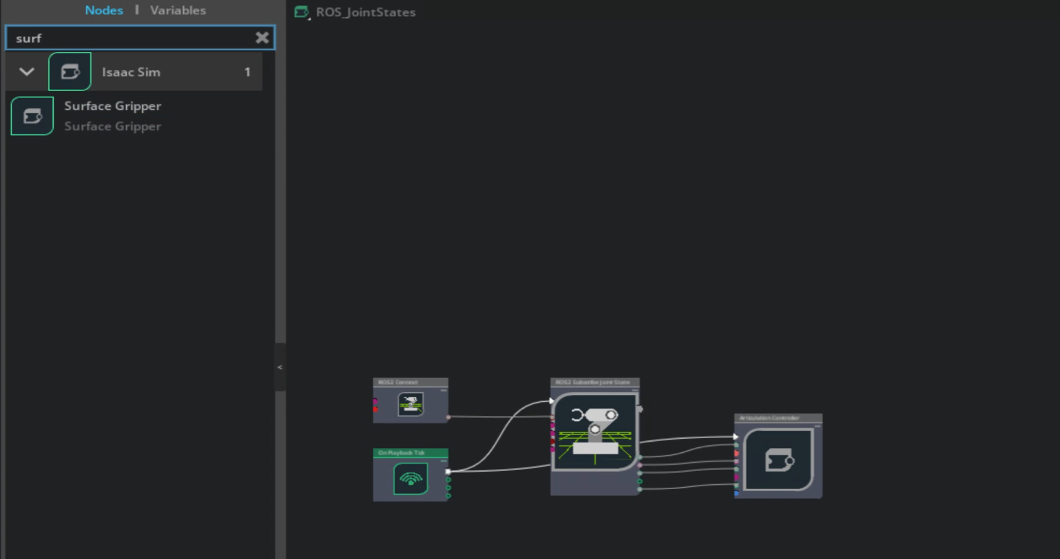
How-to: Add the Surface Gripper
Search for node: Surface Gripper
Drag node into ActionGraph

Slide 61
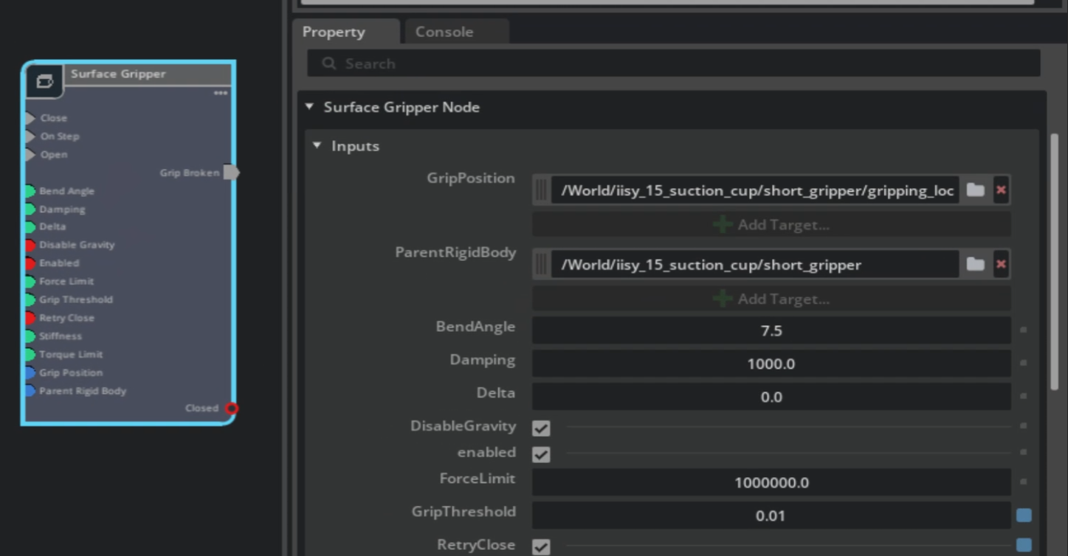
How-to: Configure the Surface Gripper

Slide 62
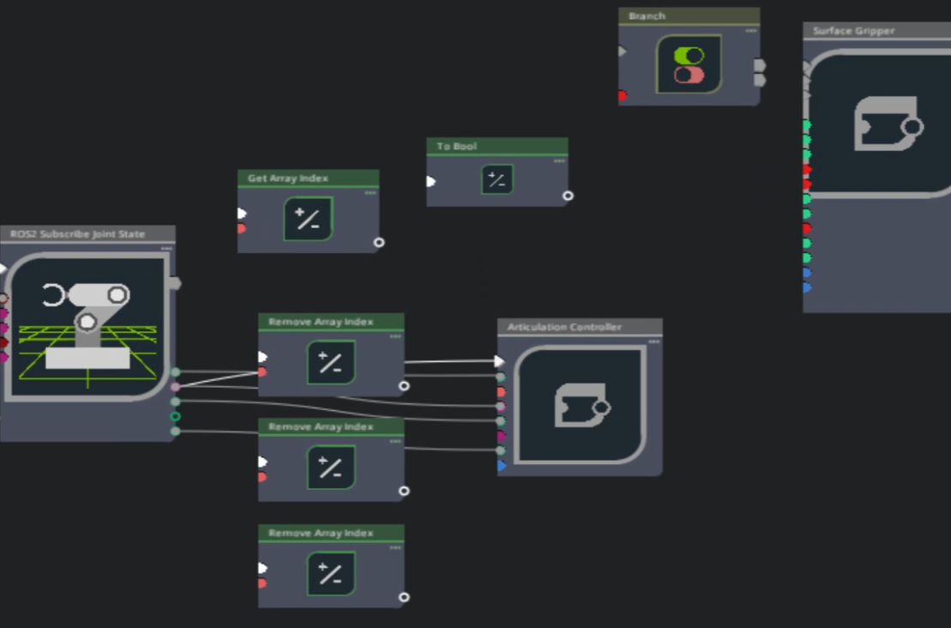
How-to: Process ROS Messages: Adding the Nodes
Search for terms and drag the nodes to the designated location
“Branch”: Add Branch node in front of surface Gripper
“Index”: Add Get Array Index node after ROS2 Subscription Set Property Inputs:Index to 6
“Index”: Add 3x Remove Array Index node vertically aligned below Get Array Index Set Property Inputs:Index to 6
“Bool”: Add To Bool node in between Get Array Index and Branch
In front of = to the left of After = to the right of

Slide 63
How-to: Process ROS Messages: Connecting the Nodes
Connect Ports by Drag&Drop:
OnPlaybackTick:Tick -> SurfaceGripper:On Step
Branch:False -> SurfaceGripper:Close
Branch:True -> SurfaceGripper:Open
ROS2Sub.:Exec Out -> Branch:Input execution
ToBool:Bool -> Branch:Condition
GetArrayIndex:Value -> ToBool:Value
ROS2Sub.:Position Command -> GetArrayIndex :Array
Remove the ROS2Sub.:Velocity Command Connection (Context menu on connection)
Replace remaining ROS2Sub. -> Artic.Contr. connections with ROS2Sub.:[x] -> RemoveArrayIndex:Array -> Artic.Contr.:[x]
Ensure the graph is opened as “ActionGraph” not “Generic Graph”

Slide 64
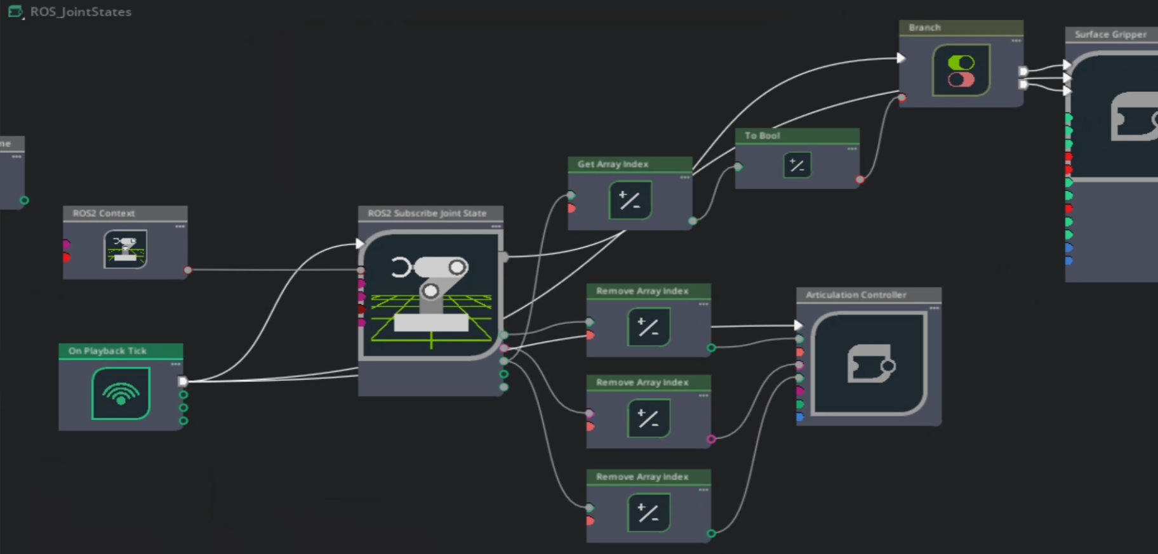
How-to: Process ROS Messages: Connecting the Nodes
Expected Result:

Slide 65
How-to: Run ROS2 Script in VS Code
Connect to*/Open your Workspace in VS Code
Open publishROS2Messages.py
Inspect it
Start the Scene in Isaac Sim
Run the Script from the VS Code Terminal:
Watch the Pick and Place Process in Isaac Sim
$ [your Isaac installation root]/python.sh ./Day2/01_PickPlace/publishROS2Messages.py
*e.g. via SSH: Remote Development using SSH

Slide 66

Assemble Your Scene
How-to↑

Slide 67
Pick & Place Phases
ee... end_effector
Phase 0: Move above the cube center at the ‘end_effector_initial_height’.
Phase 1: Move ee down to encircle the target cube
Phase 2: Wait for Robot’s inertia to settle.
Phase 3: Close grip.
Phase 4: Move ee up again, keeping the grip tight (lifting the block).
Phase 5: Move the ee toward the goal xy, keeping the height constant.
Phase 6: Move ee vertically toward goal height at the ‘end_effector_initial_height’.
Phase 7: Loosen the grip.
Phase 8: Move ee up again at the ‘end_effector_initial_height’
Phase 9: Move ee towards the old xy position.

Slide 68
Save Scene
Use the USDA format
Inspect the structure and payloads

Slide 69

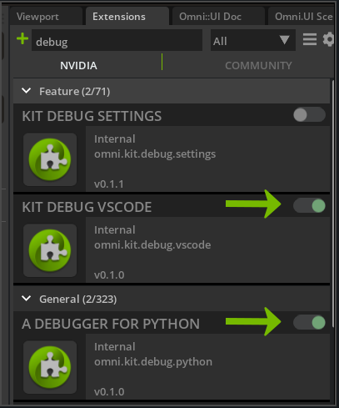
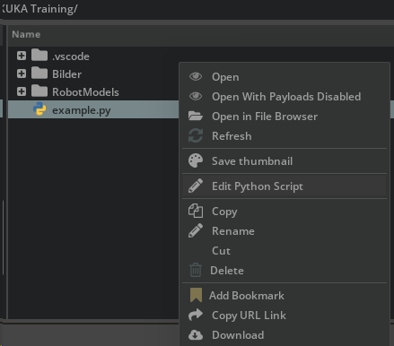
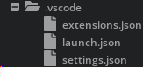
Debugging Tools
creates
https://docs.omniverse.nvidia.com/extensions/latest/ext_vs-code-link.html
If you open .py in OV, the VS Code Link dependencies are created automatically -> Enables hot reload of code

Slide 70
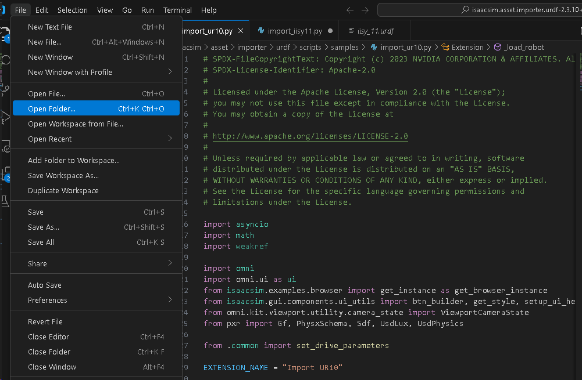
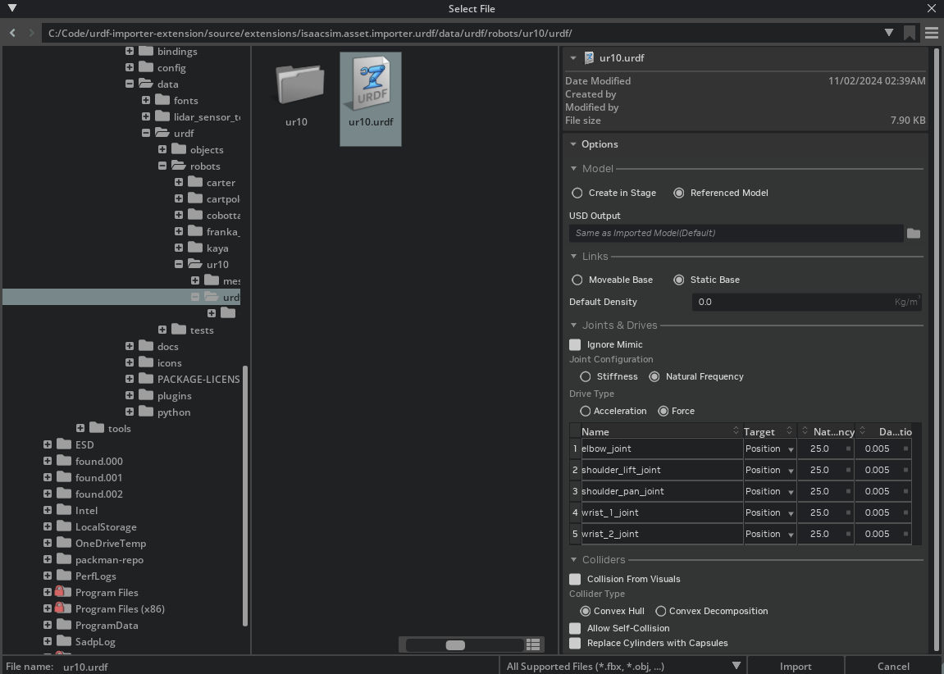
Debugging Tools
Helpful to reuse example code or look into USDA file

Slide 71
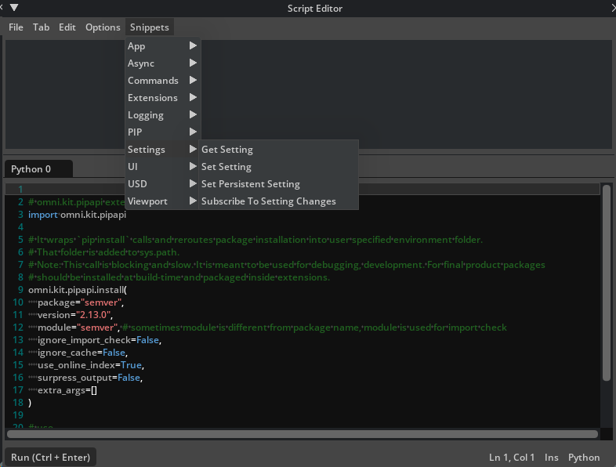

Debugging Tools
Script Editor

Slide 72
Manipulate the Scene by Python API
Open the Script Editor
Open the file scene_Manipulation.py.
Run it
Try to create another prim for example a cone:
import omni.usd import omni.kit.commands from pxr import Gf
# Get current stage
stage = omni.usd.get_context().get_stage()
# Create cube with specified parameters
result, prim_path = omni.kit.commands.execute(
"CreateMeshPrim",
prim_type="Cube",
prim_path="/World/Cube",
object_origin=Gf.Vec3f(0, 0, 0),
half_scale=50.0,
u_verts_scale=1,
v_verts_scale=1,
w_verts_scale=1 )
# Create cone with specified parameters
result, prim_path = omni.kit.commands.execute(
"CreateMeshPrim",
prim_type=" Cone",
prim_path="/World/Cone",
object_origin=Gf.Vec3f(0, 0, 0),
half_scale=50.0,# 1m Height/Diameter (dep. on def.)
u_verts_scale=1,
v_verts_scale=1,
w_verts_scale=1 )

Slide 73

Documentation
https://docs.isaacsim.omniverse.nvidia.com/4.5.0/py/index.html
Online or Local (latter might not be available)
$ cd isaacsim/docs
$ python3 -m http.server 9999
Notes:
Your best friend

Slide 74
Referencing Prims
Create new scene through GUI
Open Script Editor
Open File assemble_scene.py
Analyze Content…
Run Script
Notes:
TODO
- Prepare
- Idea -> Force use of debugging tools

Slide 75



Materials & physics Materials
Materials:
Color Map
Reflectivity
Absorption
Many others and mixtures/ Shaders
Physics Materials:
Static Friction
Dynamic Friction
Restitution
Density

Slide 76
10 min Break
Until now:
Scene Architecture
Build your Scenario: Robot, Gripper, Controller, Environment
Debugging Tools:
Console, VS Code, UI
Materials
To be continued:
Motion Planning & Motion Learning
Practical Session: Pick & Place

Slide 77
Motion Planning Libraries
Lula
Kinematics Solver (fast-forward and inverse kinematics)
Trajectory Generator (using one or more planners)
Global Planners (e.g. RRT-Connect, JT-RRT)
Local Planners (e.g. RMPflow)
CPU-based
CuMotion
Similar capabilities as Lula
Supports real-time control
Builds upon CuRobo (CUDA-accelerated)
⚠Lula algorithms require a robot_description.yaml. It contains active and fixed joints, default joint positions, collision spheres and more. This format will be superseded by the XRDF-format.
RRT…Randomly-Exploring Random Tree
RMP… Riemannian Motion Policies

Slide 78
Prerequisites for CuMotion with RMP
An URDF file, used for specifying robot kinematics as well as joint and link names. Position limits for each joint are also required.
An (X)RDF file which can be generated using the Lula Robot Description Editor UI tool. (configure drives, robot density and collision meshes)
A RMPflow configuration file in YAML format, containing parameters for all enabled RMPs.*
*For algorithms other than RMPflow different configurations and are required
Notes:
URDF extra: Other properties in the URDF are ignored and may be omitted; these include masses, moments of inertia, visual and collision meshes, etc.

Slide 79


Notes:
XML Reference - MuJoCo Documentation

Slide 80
IsaacLab Workflow – High Level
Design & Tune
Robot
Train Robot
Deploy Robot
Isaac Lab
Define Task Workflow
Support for 4 RL Libraries: RL-Games, RSL RL, SKRL, SB3
Isaac Sim
Import URDF/ Run Script
Optimize Kinematics
Generate Synthetic Data
Isaac Sim
e.g. Running on ROS

Slide 81

Notes:
[example Isaac Lab environments]

Slide 82


Task Workflows in IsaacLab
Direct RL Workflow
Manager-based RL Workflow
Notes:
Direct: The user defines a single class that implements the entire environment directly. This class is responsible for computing observations, applying actions, and computing rewards.
Manager-based: The environment is decomposed into individual components (or managers) that handle different aspects of the environment (such as computing observations, applying actions, and applying randomization). The user defines configuration classes for each component and the environment is responsible for coordinating the managers and calling their functions.
This manager-based workflow is more modular and allows different components of the environment to be swapped out easily. This is useful when prototyping the environment and experimenting with different configurations.
On the other hand, the direct workflow is more efficient and allows for more fine-grained control over the environment logic as well as the utilization of optimized frameworks such as PyTorch JIT or Warp. This is useful when optimizing the environment for performance or when implementing complex logic that is difficult to decompose into separate components.

Slide 83
Integrating ML Models
Training models on synthetic data generated in Isaac Sim or COSMOS
Foundation model as perception or reasoning module within the Isaac Lab workflow
Isaac Lab RL policy optimization
Groot N1:
Requires Trajectory Data, Video
https://github.com/NVIDIA/Isaac-GR00T/blob/main/media/model-architecture.png
π0.5
Sensory Data
https://pi.website/blog/pi05
OCTO
Generalist Robotic Policy
🐙 Octo: An Open-Source Generalist Robot Policy

Slide 84
How to generate Trajectory Data
Classic: Real Robot „imitation learning“
Trajectory generators
Applied RL policies
Teaching sim. Robot with imitation learning

Slide 85


Assemble a gripper to your robot
UI:
The Tool joins two articulation trees to one. Guides you how
Python API Code is created automatically from the UI. This can be reused for later automatically create a stage + assembly

Slide 86
5 min Break
Until now:
Scene Architecture
Build your Scenario: Robot, Gripper, Controller, Environment
Debugging Tools:
Console, VS Code, UI
Materials
Motion Planning & Motion Learning
To be continued:
Practical Session: Pick & Place
Movie Capture

Slide 87

Movie Capture Tool
Navigate to Window -> Extensions Manager using the top-level menu
Search Movie Capture in the text field, to reveal the omni.kit.window.movie_maker.
Click the toggle to enable the extension.
Open the extension in rendering -> Movie Capture

Slide 88

Movie Capture + simple Animation

Slide 89
Feedback Workshop
For further questions mail us:
fabian.fichtl@hs-kempten.de
julian.zuern@hs-kempten.de

Slide 90
Ressources & further Courses

Slide 91
Omniverse Glossary
Omniverse Glossary of Terms — Omniverse Developer Workstations

Slide 92
USD
Payload vs Reference: https://forums.developer.nvidia.com/t/usd-payload-vs-reference-vs/252658

Slide 93
Joints
https://nvidia-omniverse.github.io/PhysX/physx/5.3.0/_downloads/6acf3afb8f69452757e0e766b5a22978/implicitDrives.pdf

Slide 94
URDF Import
https://docs.isaacsim.omniverse.nvidia.com/4.5.0/robot_setup/ext_isaacsim_asset_importer_urdf.html

Slide 95
Gripper
https://docs.isaacsim.omniverse.nvidia.com/latest/robot_setup/assemble_robots.html
https://docs.isaacsim.omniverse.nvidia.com/latest/robot_simulation/ext_isaacsim_robot_surface_gripper.html
cobotta demo und anschließend mit iisy
https://docs.isaacsim.omniverse.nvidia.com/latest/robot_setup/import_manipulator.html
https://docs.isaacsim.omniverse.nvidia.com/latest/manipulators/manipulators_configure_rmpflow_denso.html#isaac-sim-app-tutorial-configure-rmpflow-denso
https://docs.isaacsim.omniverse.nvidia.com/latest/robot_setup/grasp_editor.html

Slide 96
Roboter konfiguration
https://docs.omniverse.nvidia.com/isaacsim/latest/advanced_tutorials/tutorial_configure_rmpflow_denso.html
Articulation Root -> Mobil oder stationär
https://docs.omniverse.nvidia.com/extensions/latest/ext_physics/articulations.html

Slide 97
Inverse Kinematics solver
https://isaac-sim.github.io/IsaacLab/main/source/tutorials/05_controllers/run_diff_ik.html

Slide 98
MoveIt
https://moveit.picknik.ai/main/index.html
https://moveit.picknik.ai/main/doc/concepts/concepts.html

Slide 99
Cumotion
https://nvidia-isaac-ros.github.io/concepts/manipulation/index.html#nvidia-cumotion
Isaac Manipulator consists of a set of components and reference workflows for advanced perception-driven manipulation. These components include state-of-the-art packages for object detection and object pose estimation, as well as obstacle-aware motion generation.

Slide 100
Task Space Controller
https://isaac-sim.github.io/IsaacLab/main/source/tutorials/05_controllers/run_diff_ik.html

Slide 101
Self paced Courses:
https://learn.nvidia.com/courses/course?course_id=course-v1:DLI+S-OV-31+V1&unit=block-v1:DLI+S-OV-31+V1+type@vertical+block@bd7da7c3339a42c69f073ca845778391
https://learn.nvidia.com/courses/course-detail?course_id=course-v1:DLI+S-OV-31+V1
https://learn.nvidia.com/courses/course-detail?course_id=course-v1:DLI+S-OV-15+V1
https://learn.nvidia.com/courses/course-detail?course_id=course-v1:DLI+S-OV-27+V1
https://learn.nvidia.com/courses/course-detail?course_id=course-v1:DLI+S-OV-29+V1
https://learn.nvidia.com/courses/course-detail?course_id=course-v1:DLI+S-OV-20+V1
https://learn.nvidia.com/courses/course-detail?course_id=course-v1:DLI+S-OV-28+V1
https://academy.nvidia.com/en/course/nvidia-ai-enterprise-administration/?cm=55144

